Slide 1
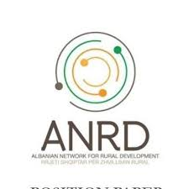
Reference Guidebook with solutions regarding biodiversity protection and sustainable agriculture:
practices from V4 countries

Slide 2
Material prepared under the project Farm to Fork Academy: V4 for Sustainable Agriculture in Albania, supported by the International Visegrad Fund and implemented by Albanian Network for Rural Development, in partnership with Rural Parliament in Slovakia, Hungarian National Rural Network, Local Action Group „Vistula – Terra Culmensis” and Czech-Moravian Association of Agricultural Entrepreneurs
Contributions by: Sylwia Szparkowska, Barbara Niewiadomska

Slide 3
The project “Farm to Fork Academy: V4 for Sustainable Agriculture in Albania” aims to promote biodiversity and its protection on various levels. It is a multidimensional initiative that tackles aspects mentioned in European Green Deal. Its educational function consists of bringing the knowledge to the farmers chosen to take part in the project. The target group is educated on the importance of biodiversity and how to ensure it on their croplands, they learn how to combine traditional knowledge with the innovative approach, resulting in increased effectiveness of food production, under the paradigm of sustainable growth.
The project’s goal is to popularize the cultivation of local plant varieties among the beneficiaries, therefore preventing the industrialization of landscape, while also encouraging farmers to take the leadership roles and make their market debut on the bigger scale, thus supporting micro and small farming.
As a result, farmers will gain knowledge and also witness in-practice measures pertaining to the enhancement of sustainability of Albanian agriculture on small farms, environment preservation, soil management and prevention of further losses in biodiversity, by implementing accurate pilots and its practical development, through the Farm to Fork Academy trainings. Furthermore, the project will trickle down the knowledge via demonstration workshops for a wider group of project beneficiaries.
Through this project, farmers will gain knowledge and also witness in-practice measures pertaining to the enhancement of sustainability of Albanian agriculture on small farms, environment preservation, and prevention of further losses in biodiversity, by implementing accurate pilots and its practical development, through the Farm to Fork Academy trainings: an open-door, competitive, intensive capacity building training programme, run in a project incubator formula, targeting young Albanian farmers and leaders, conducted along with tutor-led solution project development and the execution of 3 pilot investment schemes. Further, the project will trickle down the knowledge via demonstration workshops for a wider group of project beneficiaries.
Reference Guidebook with solutions regarding biodiversity protection and sustainable agriculture: practices from V4 countries
Farm to Fork Academy: V4 for Sustainable Agriculture in Albania

Slide 4
PRECISION FARMING
& AGRI DATA COLLECTION

Slide 5
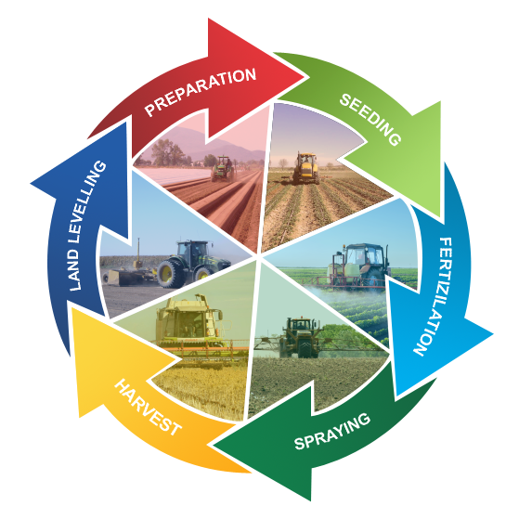
The term precision farming means a series of strategies and tools that allow farmers to optimise and increase soil quality and productivity putting in place a series of targeted key interventions, a result that can be accomplished thanks to the introduction of increasingly advanced technologies. It is referred to as “precision” because thanks to the state-of-the-art tools used, it is possible to perform the right intervention, in the right place, at the right time, responding to the specific demands of individual crops and individual areas of land with superior levels of precision.
It can help increase crop yields and animal performance and soil’s ability to retain water, reduce costs, including labour costs, and optimise process inputs. All of these can help increase profitability, work safety and reduce the environmental impacts of agriculture and farming practices, thus contributing to the sustainability of agricultural production.
PRECISION FARMING & AGRI DATA COLLECTION
PRECISION FARMING
Apart from services connected to some companies also offer land levelling, in order to reduce working time. Another positive outcome of this service is improved water distribution and drainage of farmer’s fields, which could result in savings from 20% to 50% on irrigation costs.
These systems can address every type of machinery or farm with options that cover even the most professional requirements.
https://www.mccormick.it/us/precision-farming/https://ec.europa.eu/eip/agriculture/en/digitising-agriculture/developing-digital-technologies/precision-farming-0
https://tractorgps.gr/en/precision-agriculture-solutions/

Slide 6
With 60% of global wine production being performed in Europe, traditional wine regions of this continent are the ones that will be negatively affected by climate changes in the near future. As a remedy for this problem, scientists recommend vineyard relocation or cultivation of other grape varieties, more suitable to extreme environmental conditions.
According to historic climate data, Vinum 4.0 calculates: Winkler Index, duration of growing season, to determine winds, average rainfall, average solar irradiation, and the occurrence of weather anomalies. All this information enables to find the most suitable locations for the vineyard. Firstly, there is soil analysis performed, which includes inter alia pH measurement, plant nutrients concentration, clayey soil particles content, soil dry matter density, soil water holding capacity and soil contamination. Additionally, there is also the air pollution analyzed, what includes measurements of nitrogen oxides, sulphur dioxide, fine particles PM10 and PM2,5, and ozone.
Solution offered by the Polish brand VINUM 4.0 is even more complex, as this system also includes monitoring and management. The system is based on satellite and wireless sensors data. Customers are provided with a mobile application and a set of sensors to monitor environmental conditions in the vineyard, that include temperature, insolation, air and soil humidity, precipitation and wind.
Vine-grower also receives reliable weather forecasts, and notifications regarding an occurrence of adverse weather conditions or anomalies. All the weather parameters data are collected, the application’s users are able to access them any time. Viticulture however, is not the only branch of food production that will be negatively affected by climate change in future, which is why solutions for other crop producers are available on the market as well.
PRECISION FARMING & AGRI DATA COLLECTION
VINUM 4.0
http://www.vinum40.eu/

Slide 7
GPS tracking devices allow your production manager to track harvest equipment and vehicles at all times while also protecting those pricey assets from theft. Farming equipment is a significant investment for companies in the agriculture industry. With GPS technology you can minimize unnecessary wear and tear on this expensive equipment to prolong its operational life.
Tracking systems will allow you to locate your farming equipment anywhere, at any time of day, and it can also help to organize your land and crops, ensuring that each area is getting the specific attention it requires. These systems can be programmed to arrange your land based on a system of geofences (geographical boundaries established around certain plots of land) and landmarks. When geofences or landmarks are inappropriately crossed, the user is immediately notified. Geofences establish the areas that need fertilizing, harvesting, crop dusting, and so on, and tracking equipment entry into those areas can ensure that each plot of land is receiving the appropriate cultivation at the right time.
The advantages of machine tracking include:
possibility to recover lost equipment
better management of labor costs
retrieve equipment more efficiently
prolong machine life-span
reduction of fuel consumption
ability to verify, if the service has been completed
Machine tracking will prevent unnecessary wear and tear on your machinery, the needless delivery of expensive cultivation materials, and damage to plots of land resulting from too much or too little cultivation. Fertilizers, pesticides, and even water are expensive; delivering these materials where they’re not needed can have a significant impact on your bottom line.
PRECISION FARMING & AGRI DATA COLLECTION
MACHINE TRACKING
https://www.rhinofleettracking.com/industries-using-gps-fleet-tracking/agriculture-and-farm/

Slide 8
Products from the GOtrack series allow precise, convenient and remote control over machines, tractors and fruit-growing equipment.combine our knowledge and passion in the field of precise engineering, robotics and automation with day-to-day fruit farming practices so that our projects might utilize the opportunities offered by state-of-the-art technology. The company creates solutions that make your work more comfortable, more precise, safer, reduce costs and, at the same time, significantly improve the quality of production.
On the company’s site, the user can find solution, that suits them best, with the use of the configurator.
It assesses the customers needs based on: crop type, with 3 types to choose from: horticulture trees, cultivation of blueberry bushes, market gardening perennials or system’s planned use, with 4 types to choose from: tractor remote control, maintaining a parallel tractor driving line, tractor autonomous driving, sprayer control.
Advantages of GOtrack solutions:
Time-saving: Increase the efficiency of orchard operations and work. Remotely control the work of your employees. Respect your time.
Money-saving: GOtrack universal kits provide at least the same functionality as off-the-shelf solutions and are significantly cheaper.
Safety: Our products are designed according to the strict safety requirements for this type of equipment.
Easy to use: With GOtrack, complex processes can be controlled through user-friendly interfaces with a minimum of buttons.
Easy and quick installation: Boxed solutions and universal assembly ensure short commissioning times at the customer's site.
Universal: GOtrack solutions integrate with all types of machines and equipment on the market without interfering with the machines' internal installations.
PRECISION FARMING & AGRI DATA COLLECTION
GOtrack
https://gotrack.pl/en/start/

Slide 9
Agridata platform supports farmers in the efficient management of the farm. It collects, processes and combines data collected from machines operating in the field, which allows farmers to make decisions based on proven information. They use the most modern and innovative solutions from Microsoft, which is why we are able to process millions of GPS positions a day, send data from sensors (IoT) and identify machine operators.
The Agridata system is a product of the Systemy Rolnicze company. Agricultural Systems is a Polish company that specializes in software development and the production of electronics for the agri-food industry.
Agridata is created by farmers for farmers, so their solutions are effective and tested on their own test farm, which is located in Ligota Wielka and has an area of ​​over 380 hectares.
The system that combines automatic registration of field work, field work management and ability to track the plant production process in order to increase the effectiveness of treatments and reduce costs, thus increasing the profits generated by farms.
Agridata functions for agriculture:
Records of machines, employees and land
Automated field cards
GPS monitoring with data analysis
Storage of seeds, energy, crops and fuels
Work history of machines and employees
Planning of agricultural services and treatments
Fuel, crop rotation, resource reports
Register of customers and services
Alarms and SMS notifications
The company provides its clients with the implementational service.
PRECISION FARMING & AGRI DATA COLLECTION
AgriData
https://agridata.eu/

Slide 10
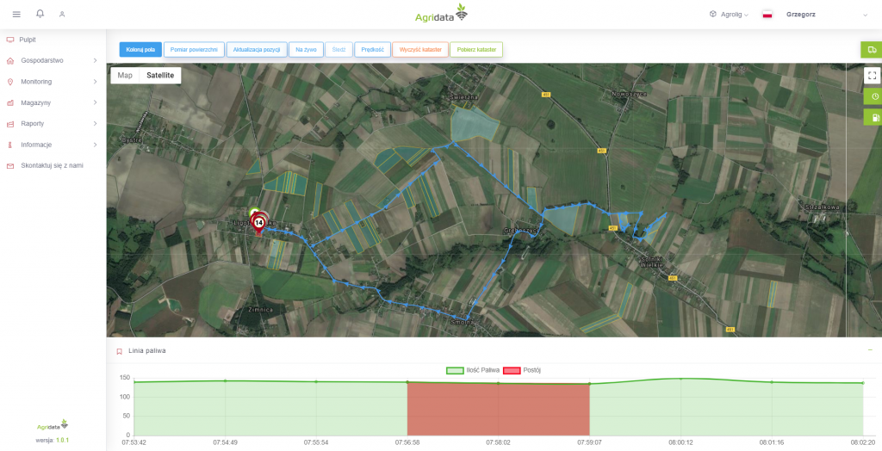
Monitoring allows you to observe: the place where the machine is currently located, who is the operator, the current operating parameters (speed, direction, surface). The system allows you to view historical data so that you can better analyze the performance of the machine, how long it takes to reach the ground, how the route was shaped.
The Agridata agricultural vehicle GPS tracking software displays a timeline with additional information about alerts (geofencing), the operator and the connected machine. You can set alarms informing about exceeding the speed of the machine, running into the ground, parking with the engine running for more than 15 minutes, for example. All work sessions for a tractor, combine harvester or other self-propelled machine are grouped by day. The calendar only displays the days on which the vehicle has been operating.
.
PRECISION FARMING & AGRI DATA COLLECTION
AgriData: GPS monitoring
https://agridata.eu/program/

Slide 11
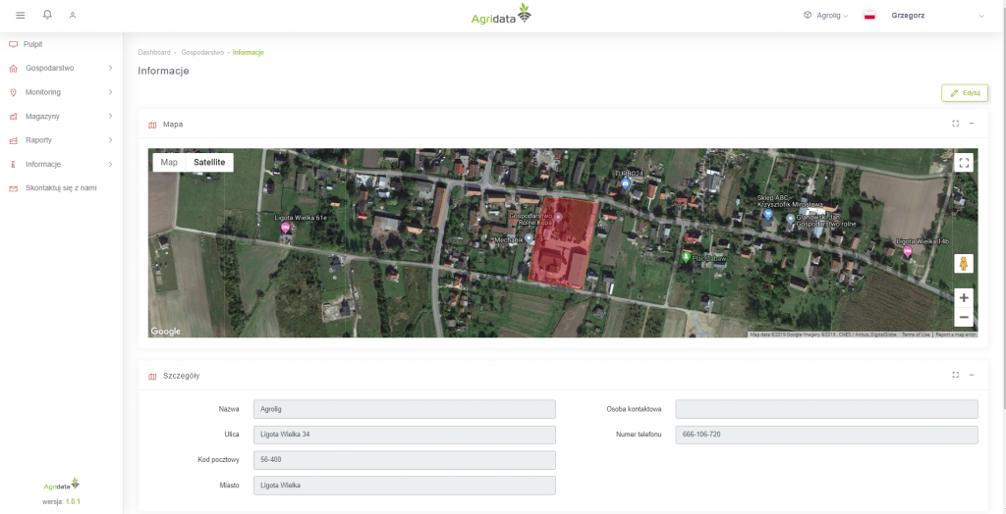
It is the most important module of the application. This is where you manage one or more farms. The Agridata system in particular facilitates the management of:
land : location, soil parameters, crops. You can group soils - having many small plots, after grouping them into one, you can massively add treatments.
employees : contact details, information about employment and authorizations. You can create an account in the system for each employee to have access to warehouses, GPS monitoring, machine park or a list of services. You can grant permissions to employees so that they can see only part of the data.
machine park : defining machines with their basic parameters, service settings and keeping a repair book, maintenance reminders, technical data.
field observations: you can add photos, descriptions, land where you have noticed plant disease, parasites or you want to observe the development of the crop.
PRECISION FARMING & AGRI DATA COLLECTION
AgriData: Farm module
https://agridata.eu/program/

Slide 12
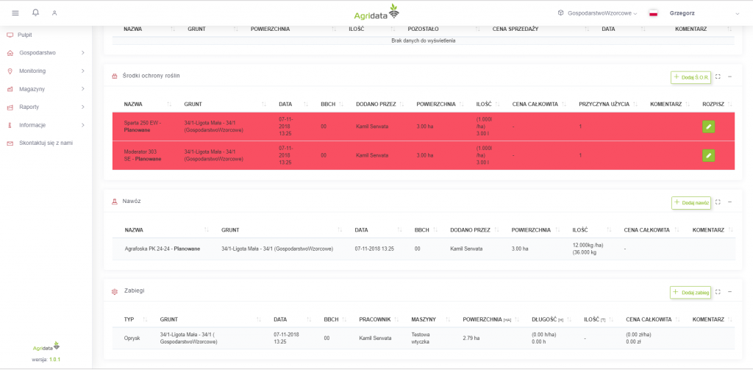
A report describing the agrotechnical treatments performed on a given land. With this report, you can optimize your costs. The field card contains information on all expenses related to employees, machine operation and profitability of the cultivation. The program allows farm managers to group land together and thus easier to administer crops or adjacent plots. The system automatically records agrotechnical procedures thanks to machine identification devices (PARO) such as a seeder, sprayer or other - freely defined. All work sessions for a tractor, combine harvester or other self-propelled machine are grouped by day. The calendar only displays the days on which the vehicle has been operating.
PRECISION FARMING & AGRI DATA COLLECTION
AgriData: Field cards
https://agridata.eu/program/

Slide 13
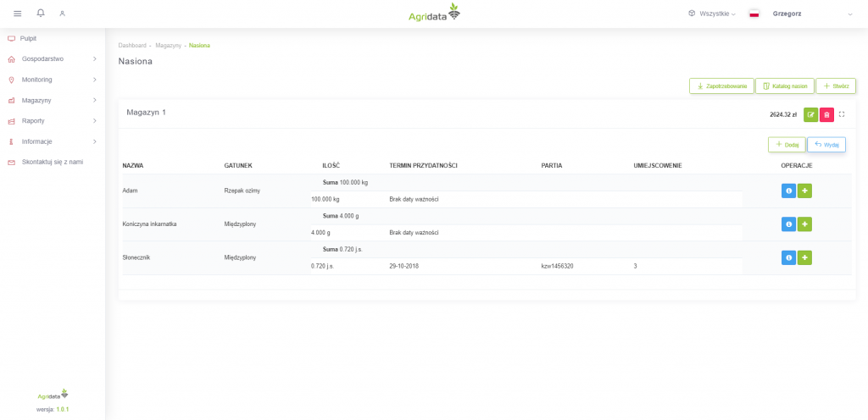
Management of the warehouse of seeds, fuels, fertilizers, crops and plant protection chemicals. Administration of buildings, location, receipt and issue of goods. You are kept informed about stock levels, so you know what you need to order. Additionally, you can use the warehouse demand function when planning crops for the next season straight from the field card being prepared.
Agridata farming software will enable you to create inventory requirements while planning agricultural operations.
PRECISION FARMING & AGRI DATA COLLECTION
AgriData: Warehouse module
https://agridata.eu/program/

Slide 14
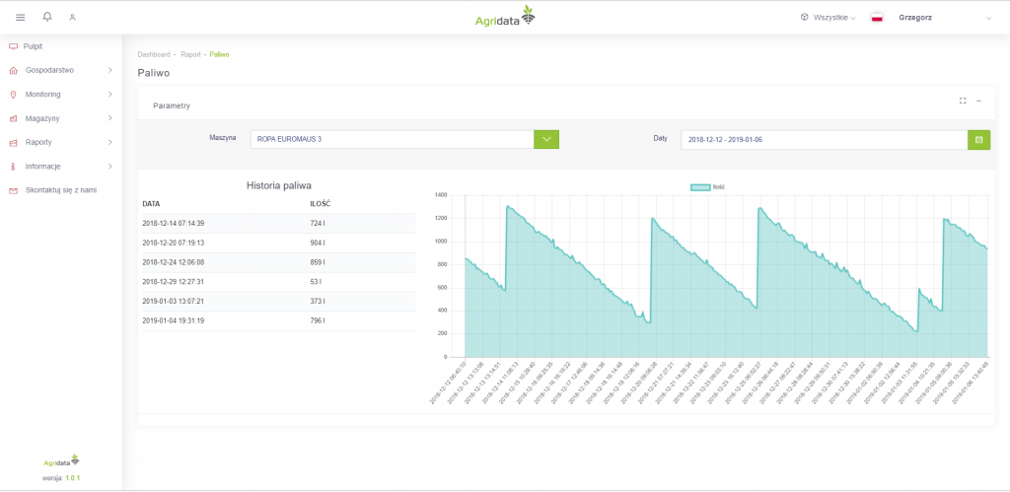
Every host and manager needs information about their entities in order to be able to better manage them. Reports prepared with this module:
automatically generated field card
crop rotation
records of plant protection products
machine operation: downtime, transport and actual work (requires LARO and PARO agricultural machinery monitoring equipment)
presence in machines (requires TARO employee identification device)
fuel report
PRECISION FARMING & AGRI DATA COLLECTION
AgriData: Reports module
https://agridata.eu/program/
https://agridata.eu/program/

Slide 15
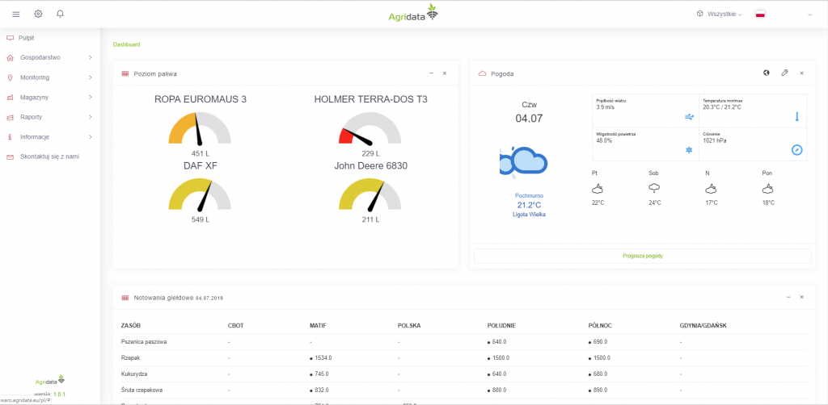
The desktop module is where information about your farm and services is aggregated:
service notifications for your customers with a close deadline
inspection notifications
PIORIN messages in your county
weather for your locations
The common functions of the app module are:
accurate maps with embedded information (crops, machines, cultivation environment)
SMS and e-mail notifications
alarms when machines move out of the allowed area, fuel changes
crop management
PRECISION FARMING & AGRI DATA COLLECTION
AgriData: Desktop and app modules
https://agridata.eu/program/

Slide 16
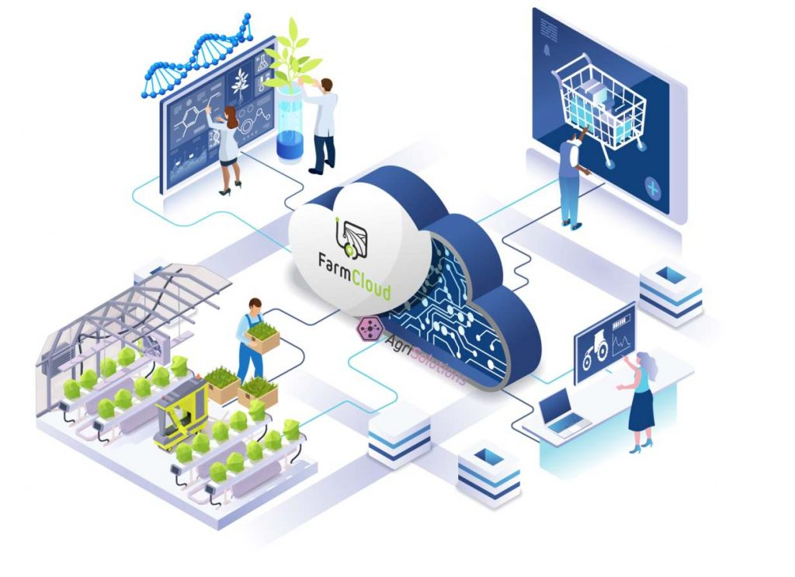
FarmCloud is Agridata's elevated IT platform for the agri-food industry that integrates all parties involved in production. Its aim is to enable better collaboration between actors in agri-food production through building business relationships, process and product optimization, information exchange and shortening of the supply chain.
FarmCloud consists of two main applications:
FarmPortal - a comprehensive farm management system dedicated to farmers, can be used successfully both on small farms with low degree and need of automation as well as on medium and large farms where full control of resources, optimization of production and automation is required. FarmPortal is an intuitive software for complex farm management, crop production, vegetable production and Agro forestry using IoT sensors. Farmers can get management software for free, the company produces their own sensors, compatible with various tractors.
AgriCRM - for service companies, trading companies, solution providers to cooperate with farmers / suppliers.
PRECISION FARMING & AGRI DATA COLLECTION
AgriData: FarmCloud
The platform includes other features, such as:
multiple farms management, e-commerce support,
built-in messenger between farmers and service companies,
dissemination of digitization and new technologies,
data security and access control.
https://agridata.eu/program/

Slide 17
FOOD PROCESSING - COOPERATIVE SOLUTIONS

Slide 18
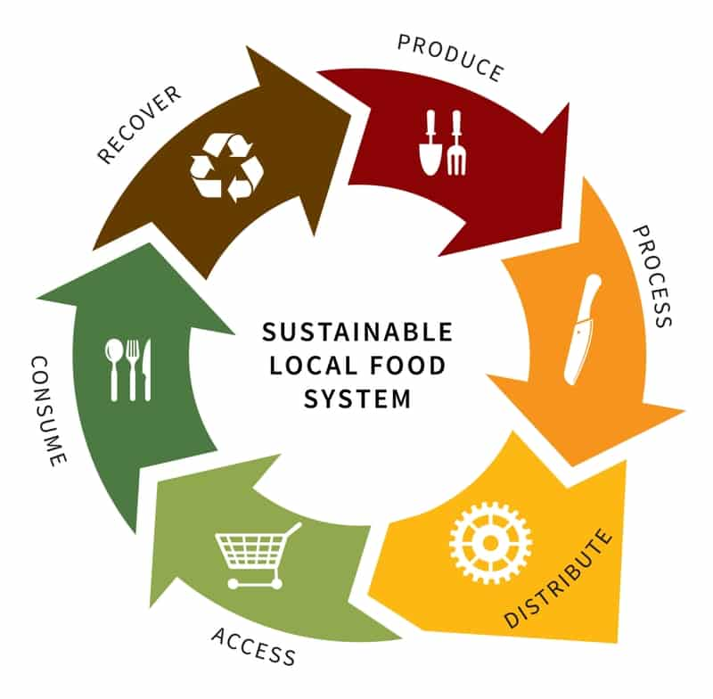
Since food-processing not only extends products’ shelf-life, but it is also a key-factor of generating added value of the product, rural communities must strive for innovation in this aspect, which will ultimately lead to the higher income, as well as the income diversification.
Shared food processing infrastructure available to the community can create opportunities for amateur food producers, who can test their processing skills and abilities to market (packaging, labeling, distribution and sales) their own, original products in compliance with sanitary regulations, instead of starting with a costly investment to build a new plant, the unprocessed food producer.
FOOD PROCESSING - COOPERATIVE SOLUTIONS
COOPERATIVE SOLUTIONS AND SHARED INFRASTRUCTURE
Shared food processing infrastructure is one of the possible means to achieving sustainable food system (SFS) within the community. It is such a food system that delivers food security and nutrition for all in such a way that the economic, social and environmental bases to generate food security and nutrition for future generations are not compromised.
Which means that:
– It is profitable throughout (economic sustainability);
– It has broad-based benefits for society (social sustainability); and
– It has a positive or neutral impact on the natural environment (environmental sustainability).
https://cultivatecommunityfood.coop/solano-local-food-system-alliance/
http://www.fao.org/3/ca2079en/CA2079EN.pdf

Slide 19
The concept of government and nonprofit organizations providing physical infrastructure to enable individuals and organizations to manufacture food and agricultural products is not new, and goes as early as 1918 when the concept of community canneries was already well-established. In the opinion of the researchers, a shared-use food and/or agricultural production facility is one that centers on two equally important, critical elements of food or agricultural entrepreneurship.
First, it provides access to the physical processing needs of users in a shared-use environment. Multiple users employ the facility to store their raw ingredients (dry, cooler and freezer), packaging materials and frequently their finished products. The facility also provides the means of production for the users by scheduling access to commercial or production-grade processing equipment.
Equally important, these facilities implement food and agricultural entrepreneurship programs. They frequently provide business support services through business training, technical assistance and access to capital through relationships with state, regional and local-area service providers. Support services can also include office space, conference rooms, computer access, secretarial and phone answering services and management guidance and mentoring. Infrastructure built to support farming and food-processing often can be shared among industry users operating close to one another.
The such establishments can serve as a mean to activate, incubate and provide assistance to farms in the production process and marketing of local products by providing them with access to full technical infrastructure, which meets the sanitary and hygienic requirements necessary for the production, which is why farms engaged in the production and sale of products processed on the basis of their own fruit and vegetables experience vast economic benefits.
FOOD PROCESSING - COOPERATIVE SOLUTIONS
SHARED INFRASTRUCTURE
https://www.smithsonmills.com/ncshareduse.pdf

Slide 20
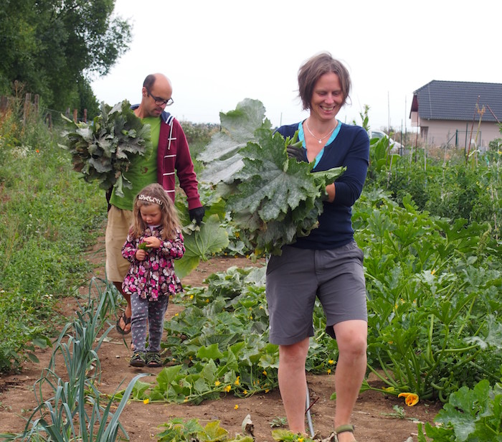
Alongside vegetables, the cooperative cultivates variety of flowers and other plants that contribute to the diversity and soil’s health, such as: sunflowers, marigolds, asters, zinnias and other annuals together with perennials grown in no-tilt areas. In the orchard they grow over forty fruit trees which increase significantly the variety of our produce.
In some parts of the land they start the experiments with the popular and modern no-tilt methods looking forward to evaluate and compare the results with those achieved through old-fashioned practices.
FOOD PROCESSING - COOPERATIVE SOLUTIONS
KOMPOT: BIODIVERSITY IN PRAGUE’S OUTSKIRTS
Results of the cooperative solution:
Farmers are able to produce annual harvest of about 6 tons of vegetables; harvest begins when they have at least five vegetable sorts.
The cooperative harvests: lettuce, kohlrabies, radishes, spinach and a bunch of leaf parsley, tomatoes, cucumbers, courgettes, green beans, peppers, eggplants, leeks, berries and many other sorts (the weight of one share reaches up to 10 kilos) potatoes, carrots, beetroots, squashes, kale and Brussels sprouts for real gourmets.
Biodiverse ecosystem: The garden houses earth organisms, insects, birds and other species.
https://kom-pot.cz/en/about-us/
http://www.cultivatecollective.org/in-practice/alternative-food-systems-in-the-czech-republic/

Slide 21
Registered association KomPot runs a productive community garden in Nové Středokluky based on the principles of the community-supported agriculture (CSA).
In Czech KomPot is the abbreviation for “community food.” The idea to start first community CSA in the Czechia was born in 2011 in PROBIO-LIGA where the paths of Míla Hilgetová and Jan Valeška crossed. Míla´s family offered 1,5 acres of land on which Mila´s grandma used to grow vegetables in the past. Together with other engaged and excited people they began to build KomPot following the foreign examples.
KomPot employs experienced gardener and occasionally other helping hands. Some of the tasks lay upon the shoulders of the members: they assist in growing, structure maintenance, administration, finances and communication. Some of them are beekeepers.
So far they follow traditional agriculture methods with the autumnal tillage. Vegetable beds are organized in the traditional three-course crop rotation plan. They do not use any chemical fertilizers a pesticides in accordance with the principles of organic agriculture. The first area of the three-course rotation plan is fertilized with the horse manure, second with the green fertilizer (usually Blue Tansy or Vetch) or compost and the third is left unfertilized for the nitrogen producing crops such as peas and beans.
In the first course they lay the drip irrigation and cultivate seedlings of the cabbage family crops, salads, root and stem celery, peppers, eggplants. In second course they cultivate all the other roots- carrots, beetroot, parsley and parsnip, also leeks and onions, courgettes, squashes, tomatoes, radishes and so on. When useful they lay the protective textiles on the beds against pest and frost damage and to enhance the germination of seeds sowed directly. When possible they also apply the knowledge of companion planting growing onions next to carrots, strawberries next to garlic, kohlrabies in mixed cultures with salads an so on.
FOOD PROCESSING - COOPERATIVE SOLUTIONS
KOMPOT: BIODIVERSITY IN PRAGUE’S OUTSKIRTS
https://kom-pot.cz/en/about-us/
http://www.cultivatecollective.org/in-practice/alternative-food-systems-in-the-czech-republic/

Slide 22
The Center for Business Promotion and Entrepreneurship in Sandomierz, Poland is a non-profit foundation founded in 1991 by the Senator of the Republic of Poland Zbigniew Romaszewski and TechnoServe, an American, non-profit organization supporting the development of entrepreneurship in many agricultural regions of the world.
The Center for Business Promotion and Entrepreneurship aim is to lead and accelerate the economic transition in rural Southeastern Poland. Its early programs concentrated on agribusiness development. In recent years, its efforts expanded into general business development as well as into public sector economic and development planning and non-governmental organizations.
One of its initiatives is a a processing incubator in Dwikozy, Poland, established in 2016. The Centre for Business Promotion and Entrepreneurship in Sandomierz, acting in a partnership with the Commune of Dwikozy, intends to establish and operate a processing incubator, also referred to as a kitchen incubator in Dwikozy. The Project is implemented under the “Świętokrzyskie Mountains Our Future” Programme co-financed by the Swiss-Polish Cooperation Programme.
This type of cooperation of the community supports the farmer, food-security and biodiversity and is more eco-friendly due to the lower CO2 emissions generated through the transport. Onsite processing also generates added value and encourages the model of circular economy, with the nutritional needs of the community being satisfied by local producers, which results in higher incomes. Economic benefits will be experienced by those farms which engage in the production and sale of products processed on the basis of their own fruit and vegetables.
FOOD PROCESSING - COOPERATIVE SOLUTIONS
FOOD PROCESSING INCUBATOR IN DWIKOZY
http://dobresandomierskie.pl/

Slide 23
Equipment available at Processing Incubator in Dwikozy:
multi-purpose, compact machine for physical (vacuum and high pressure), mechanical (mixing and homogenization) and thermal (possibility of reaching sterilization temperature 120 Celsius degrees) processing of fruits and vegetables. It has the ability to cut, grind, mix, homogenize, refine and emulsify products, and has the ability to work in vacuum evaporator mode
chamber dryer for drying herbs and vegetables, in which at one time can be placed up to 4500 kg of fruit, the drying factor is hot air
apple peeler
stone fruit stamper
slicer - shredder with exchangeable discs
fruit shredder
a juice press
flow pasteurizer with juice pouring machine
pasteurizers for jars with preserves
press for pressing oil
quick-freeze freezer (blast chiller)
product packaging machines
ice cream sorbet machine
combi steam oven
gas cooker
heating stool
and small equipment necessary to work in the kitchen.
FOOD PROCESSING - COOPERATIVE SOLUTIONS
FOOD PROCESSING INCUBATOR IN DWIKOZY
http://dobresandomierskie.pl/

Slide 24
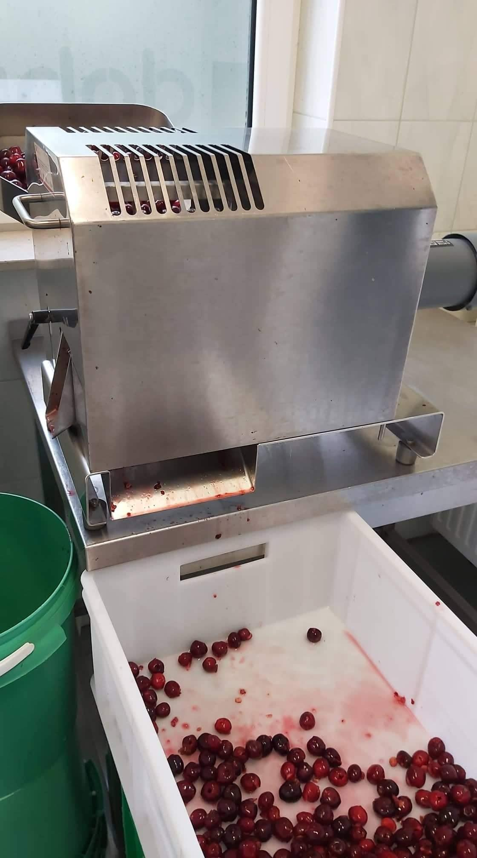
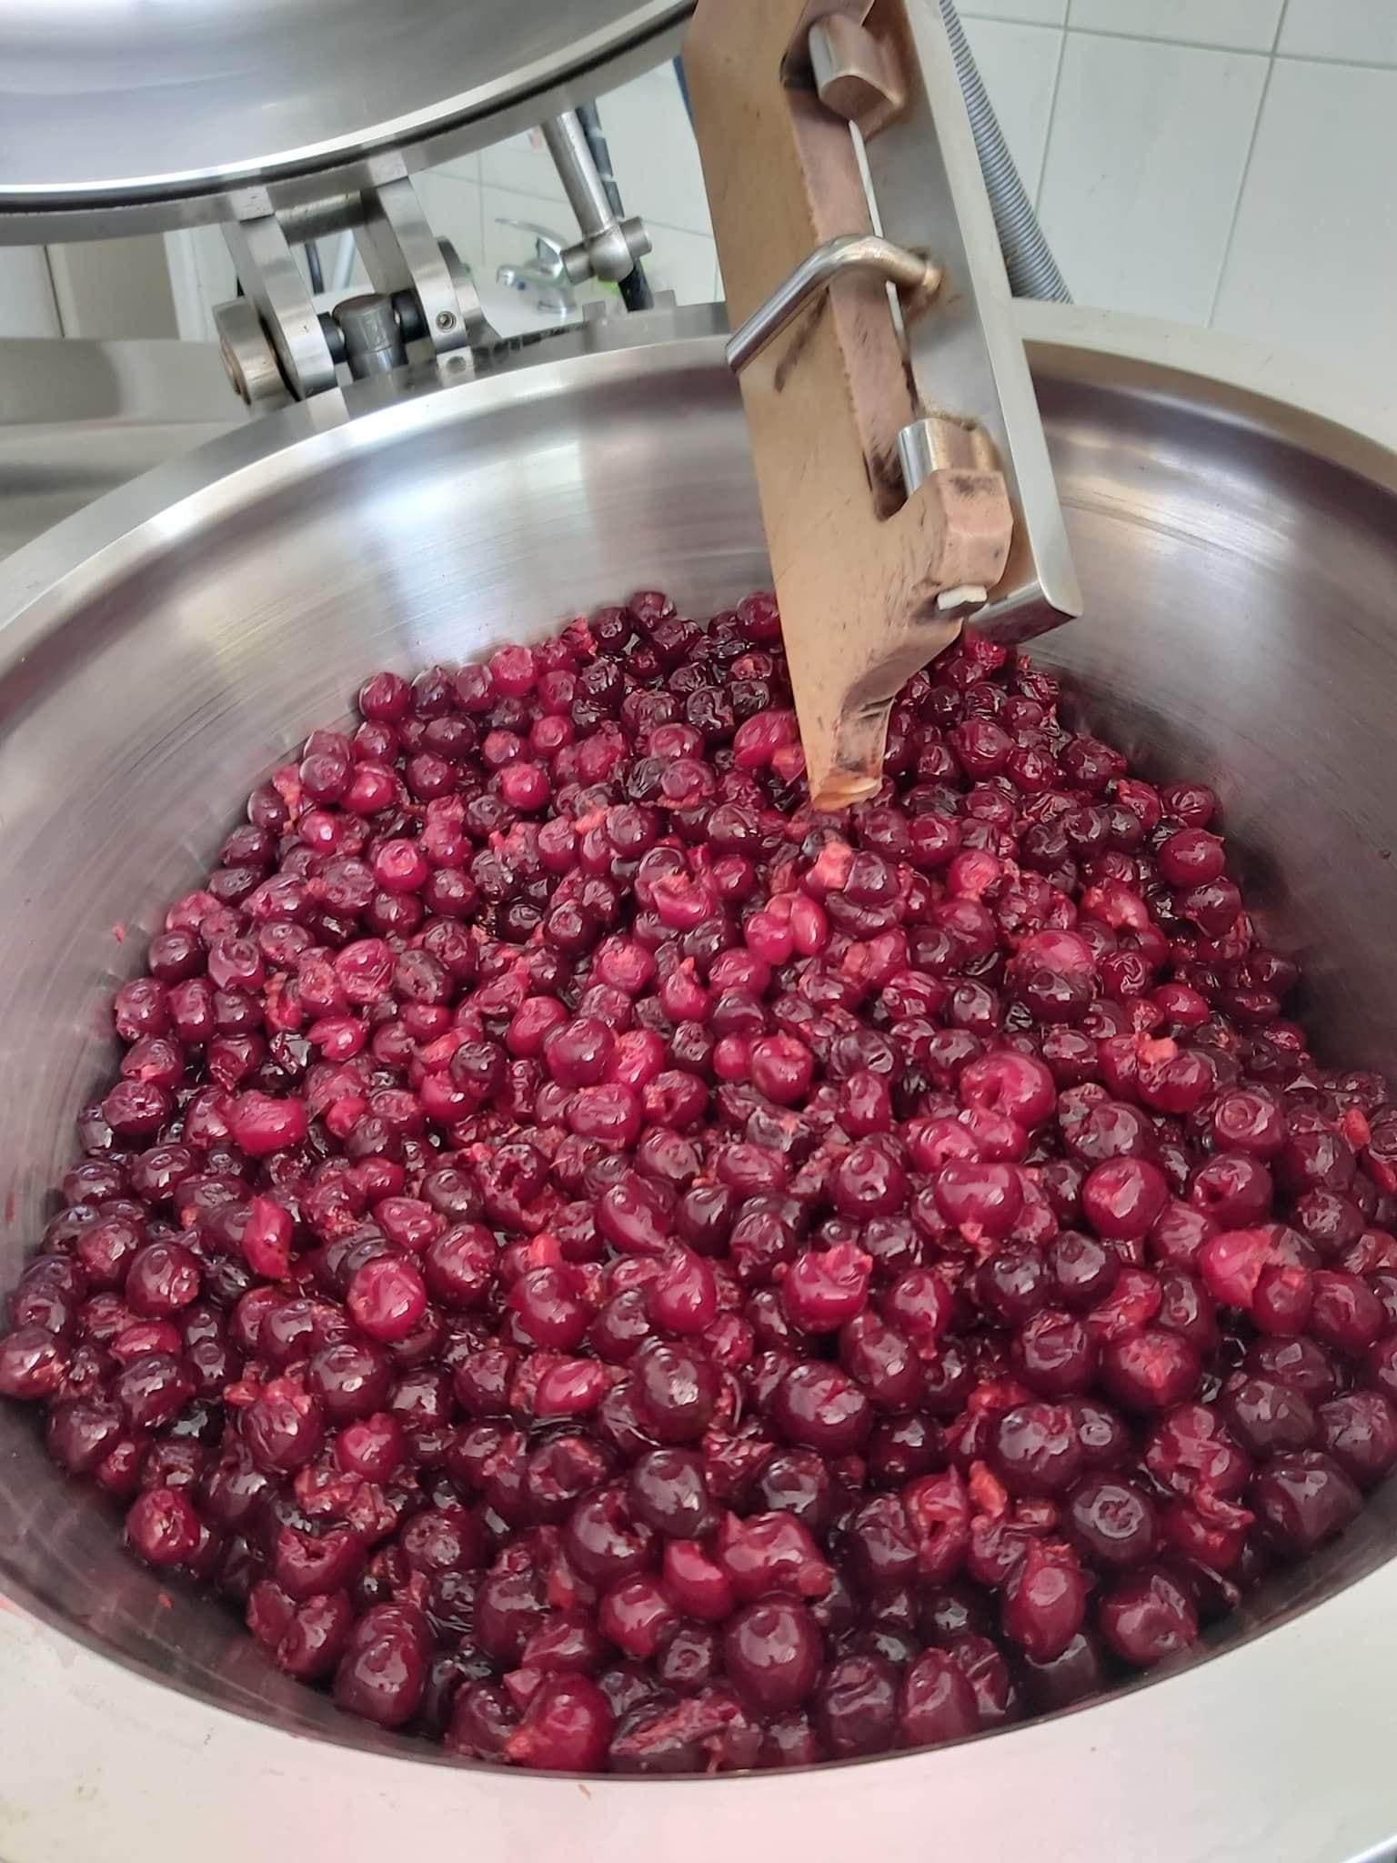
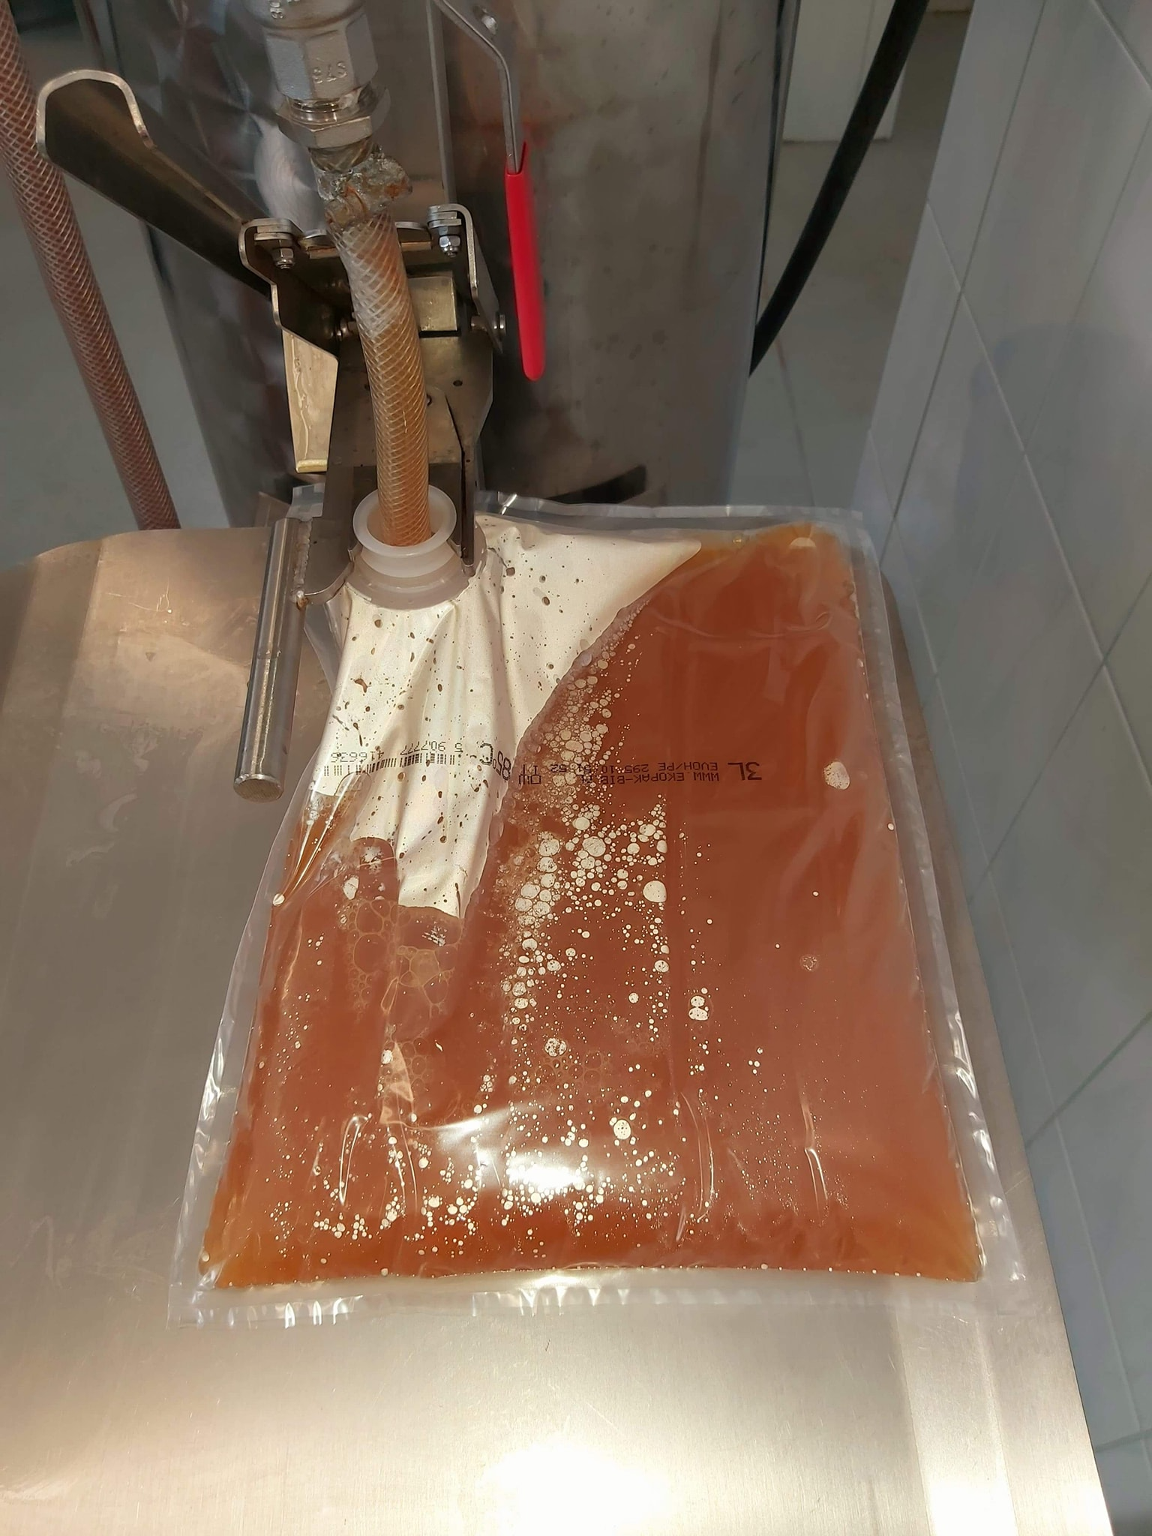
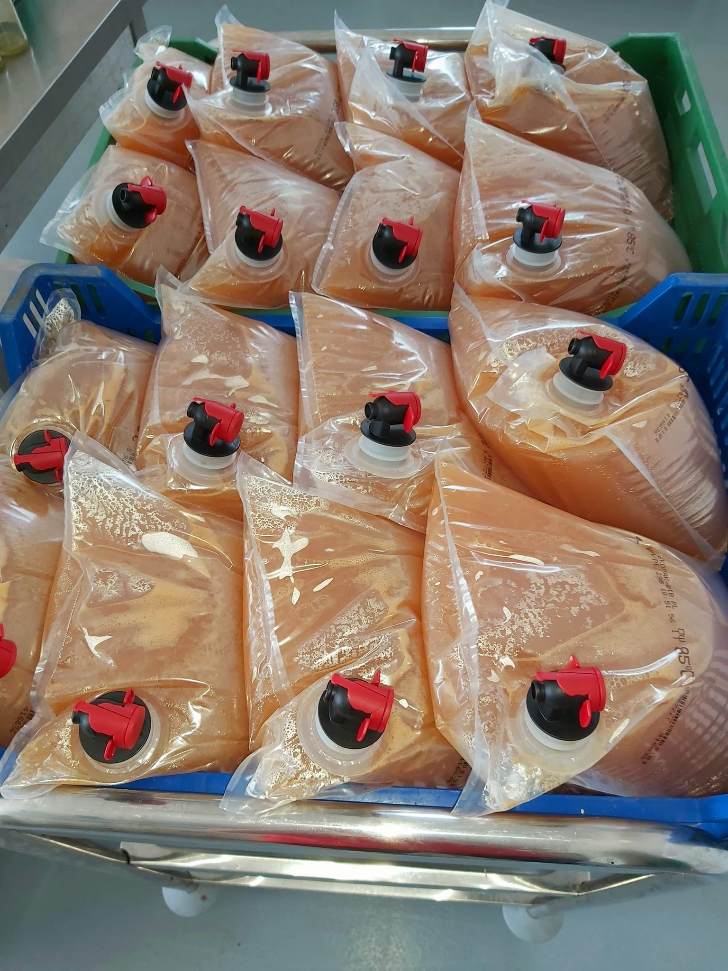
FOOD PROCESSING - COOPERATIVE SOLUTIONS
Source: @inkubatorprzetwórczywdwikozach’s Facebook post from 27.06.2021
Source: @inkubatorprzetwórczywdwikozach’s Facebook post from 18.08.2020

Slide 25
WATER: TREATMENT AND MANAGEMENT

Slide 26
Ecotourism as a concept dates back to the 1970s, although it was only defined in 1990 by the International Ecotourism Society, which described ecotourism as, ‘Responsible travel to natural areas that conserves the environment and improves the wellbeing of local people’.
Despite this and other efforts to formalize the concept, ecotourism has always been hard to define in a precise manner. There are, however, seven criteria established by Martha Honey, the CEO of Center for Responsible Travel, with which to distinguish legitimate ecotourism from ‘greenwashing’ and ‘ecotourism lite’.
These criteria are, respectfully:
to travel to natural destinations;
to minimize impact;
to build environmental awareness;
to provide direct financial benefits for conservation;
to provide financial benefits and power for local people;
to respect local culture;
and to support human rights and democratic movements.
This section of the guide focuses on criteria number 2, 3 and 5, by presenting various techniques that can be used in order to decrease costs of providing water and sewage disposal, while decreasing the environmental impact, decentralizing wastewater treatment infrastructure and increasing the comfort of tourists, thus making the accomodation site more attractive and comfortable, which can have a direct impact on the profitability of the local tourism.
WATER: TREATMENT AND MANAGEMENT
THE NEED FOR SUSTAINABLE WATER TREATMENT AND MANAGEMENT
https://onlinelibrary.wiley.com/doi/full/10.1111/j.1477-8947.2009.01256.x

Slide 27
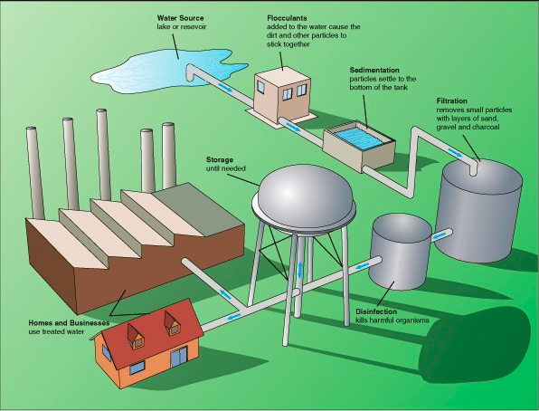
Decentralized wastewater treatment effectively and efficiently treats domestic sewage to protect water quality and support local water supplies. The wastewater from decentralized systems stays in the local watershed as it returns to the drain field, dispersing into the underlying soil and eventually recharging groundwater and/or reentering the local watershed.
Advanced decentralized treatment systems can achieve treatment levels comparable to centralized wastewater treatment systems while minimizing the level of phosphates and nitrogen entering the groundwater. Discharging to the soil can further remove contaminants so as to maintain water quality.
WATER: TREATMENT AND MANAGEMENT
DECENTRALIZED WASTEWATER TREATMENT
Decentralized systems can be designed to meet specific treatment goals, to handle unusual site conditions, and to address local environmental protection requirements.
Using decentralized systems may also make it easier for a community to employ water reuse techniques and, as a result, reduce the demand for treated drinking water.
https://smallwatersystemsbc.ca/centralized-vs-decentralized-water-treatment-systems
https://www.epa.gov/sites/default/files/2015-06/documents/mou-green-paper-081712-v2.pdf

Slide 28
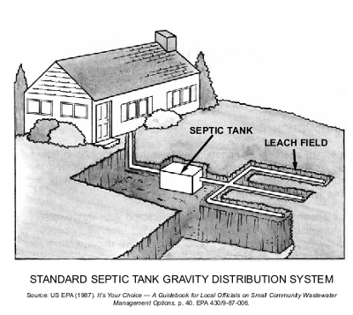
Home wastewater enters the septic tank, which separates solids from liquids. Solids are held in the septic tank and liquids are conveyed to the final soil treatment site. The septic tank is a “bioreactor” where microorganisms break down organic matter in the wastewater to liquids, gases and solids. Gases are vented off through the house vent stack. Solids are composed of both sludge and scum, which is lighter than water and floats to the surface in the septic tank. The solid parts are heavier than water and sink to the bottom of the tank. Bacteria feed on the wastes and the fraction that can’t be decomposed is “sludge.” Sludge accumulates in the bottom of the septic tank and must be removed periodically.
WATER: TREATMENT AND MANAGEMENT
SUSTAINABLE SEWAGE DISPOSAL
The size of the septic tank you need depends on the number of bedrooms in the home, number of people living there, the home’s square footage and whether or not water saving fixtures are used. So, for example, a house with 2 bedrooms requires a tank of 750 cubic litres. The cubacity roughly increases by 250 litres, with every bathroom added.
Properly sized tanks generally have enough space to accumulate sludge for at least 3 years. Keeping track of sludge removal is important because if it accumulates for too long, the sewage goes directly to the soil absorption area, and little is treated.
http://www.waldeneffect.org/blog/Conventional_methods_of_sewage_disposal/

Slide 29
Sustainable water management means using water in a way that meets current, ecological, social, and economic needs without compromising the ability to meet those needs in the future. It requires water managers to look beyond jurisdictional boundaries and their immediate supply operations, managing water collaboratively while seeking resilient regional, or even household-level solutions that minimize risks of water scarcity and environmental pollution.
Ekodren is a family run business that provides such sustainable water management solutions, with over 20 years in the industry and 3 generations of entrepreneurs being present and active. Their employees are both theoreticians and practitioners, and it is the only company in Poland that conducts research projects for wastewater treatment systems in cooperation with the testing ground for individual wastewater treatment systems at the Institute of Technology and Life Sciences in Tylicz, Poland.
The company offers domestic sewage treatment plants (biological, tunnel and drainage), sewage water infiltration, local sewage treatment plants, bacteria for sewage treatment plants, rainwater collection systems, sewage separators, sewage sumps, pumping stations, some of which are suitable for self-assembly and installation, with the warranty still being valid. Solutions provided by Ekodren include site selection, depending on various physical parameters and investor’s expectations, services of technical advisor, who supervises the investment’s implementation and its commissioning, as well as user training and documentation of the implemented investments.
WATER: TREATMENT AND MANAGEMENT
EKODREN: SUSTAINABLE WATER MANAGEMENT
https://waterfdn.org/sustainable-water-management-swm-profile/
https://www.graf-water.com/wastewater-treatment/all-about-wastewater-treatment/how-does-a-sbr-wastewater-treatment-system-work.html
https://ekodren.pl/

Slide 30
Sequencing batch reactors or SBRs use a separate pre-treatment section to mechanically hold back solids and a biological aeration and settling tank. Small SBR wastewater treatment systems clean incoming wastewater over a number of cycles.
How does SBR technology work?
1. Charging - The wastewater goes first into primary treatment (1st chamber), where the solid substances are retained. From there, the wastewater is fed into the SBR tank (2nd chamber).
2. Aeration - The actual biological cleaning by microorganisms now takes place in the SBR tank. Short aeration and rest phases alternate in a controlled cleaning process. The so-called activated sludge can now develop with millions of microorganisms and clean the water thoroughly.
3. Rest phase - A rest phase now follows, during which the live sludge sinks to the bottom of the system. This allows a clarified water zone to form at the top of the SBR tank.
4. Clear water extraction - The purified wastewater is now fed into a discharge system (stream, river, sea) or into an infiltration system. Afterwards, the sludge is fed back from the SBR tank into the first.
WATER: TREATMENT AND MANAGEMENT
SBR WATER TREATMENT PLANTS
https://www.graf-water.com/wastewater-treatment/all-about-wastewater-treatment/how-does-a-sbr-wastewater-treatment-system-work.html

Slide 31
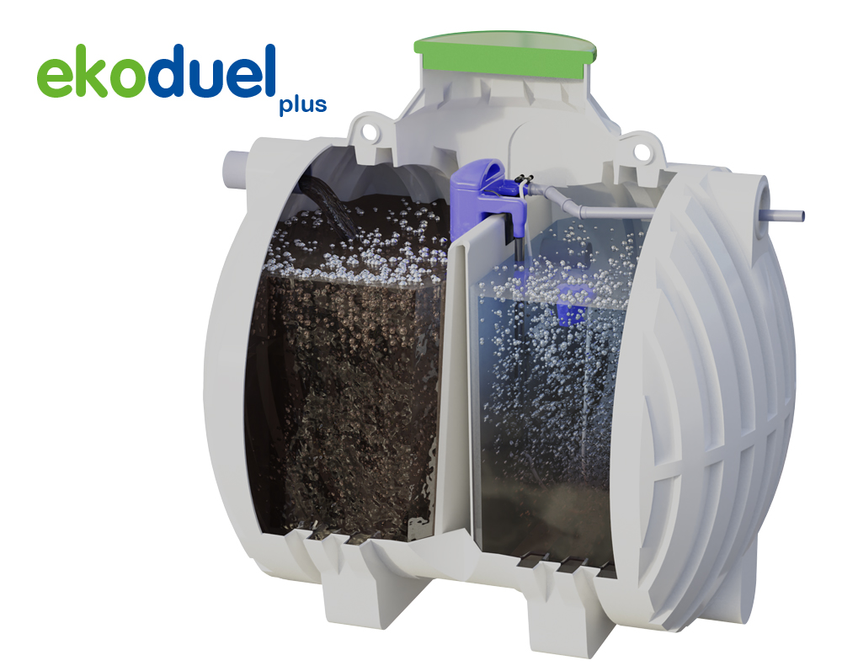
The company offers biological sewage treatment plants of SBR type - EkoDuel and EkoDuel Plus, developed in cooperation with German, Slovenian and Lithuanian partners.
These advanced household biological sewage treatment plant of the SBR type:
Are fully automated and adjust to the amount of wastewater;
Have digital control panel with LCD display;
Have automatic vacation mode;
Are odourless and easy to use.
Are energy saving - electricity consumption - only 0,64 kWh/d;
Have to have excess sludge removed once a year.
Are environmentally friendly - generates negligible amounts of surplus sludge;
Have a treatment efficiency up to 93.5%
Have innovative, monolithic, compact tank with baffle
Have reinforced, high groundwater resistant construction.
WATER: TREATMENT AND MANAGEMENT
EKODREN: SBR SEWAGE TRATMENT PLANTS
Total cost of the investment: around 3200 euros (international shipping cost not included), with 10-year warranty for the tank.
https://ekodren.pl/

Slide 32
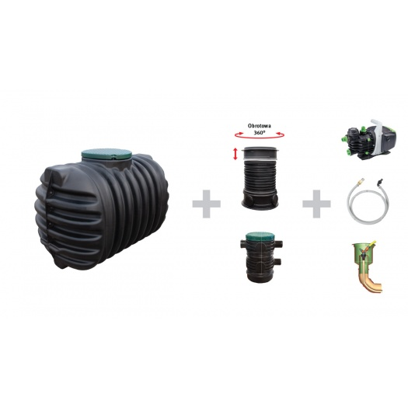
Grey water refers to water sourced from kitchen (depending on national regulation), laundry and bathroom drains, but not from toilets. Grey water may contain urine and faeces from nappy washing and showering, as well as kitchen scraps, soil, hair, detergents, cleaning products, personal-care products, sunscreens, fats and oils]. Domestic wastewater (excluding fecal matter and urine) from bathrooms, basins, showers is called light grey water - LGW.
Contaminated or difficult –to-handle grey water, such as solids-laden kitchen sink water or from laundry is called dark grey water. Grey water systems depend significantly on the behavior of the people using the collection appliances, as well as the quality and volume of water collected. There are many different methods used to filter/treat collected grey water, which range in complexity and the level of treatment.
WATER: TREATMENT AND MANAGEMENT
RAINWATER COLLECTION AND GREYWATER TREATMENT
Under the conditions of residential areas, applied rainwater harvesting systems are able to reduce drinking water demand even by 60–80%/. The lower consumption of drinking water delivered by the water supply network, reduces payment for delivered water and discharged sanitary wastewater. In the case of communes in which connection to municipal stormwater system is obligatory, the installation of RWH systems allows avoiding stormwater fee payment.
Costs of single-chambered water harvesting systems start at 1300 euros.
https://www.irbnet.de/daten/iconda/CIB_DC27602.pdf
https://ekodren.pl/p/system-cristal-ogrod-eco-2800/

Slide 33
ASIO, spol. s r.o. was established in 1993 as a Czech engineering supplies company with international operations. The company is involved in the development, production, and delivery of technologies for wastewater treatment, water treatment and air treatment. The wide range of water management products that it offers are employed in the treatment of wastewater from family houses, villages, towns, hospitals, and in various branches of industry.
ASIO is a Czech company represented in 32 countries, through a wide network of subsidiaries and representatives. Besides its quality production base, it has built a network of sales and service centres not only in the Czech Republic, but also in a number of European countries. All the closely cooperating companies are associated within the framework of ASIOgroup. The organisation has in place the quality management system according to ISO 9001:2015 and the environmental management system according to ISO 14001:2015; its corporate governance involves the policy of quality and environmental protection. In the development sphere, it cooperates with many academic institutions and universities, such as civil engineering and chemical technology universities.
ASIO, spol. s r.o. offers the preparation of expert statements, consultant services, studies and designs, audits and preparation of operating rules for:
water management optimisation,
design of economically suitable technologies of greywater purification,
economic evaluations of proposed technologies of greywater purification,
detailed processing of operating costs,
proposals for rational solutions, process flow diagrams, operating parameters and modes, and
suitability evaluations for various types of building structures.
Applications in the following spheres: family houses, apartment houses, wellness centres, swimming pools, bath houses, office block, hotels, industrial plants, and sports centres.
WATER: TREATMENT AND MANAGEMENT
ASIO: GREY WATER TREATMENT
https://www.environmental-expert.com/companies/asio-spol-s-ro-29724
https://www.asio.cz/en/company

Slide 34
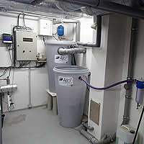
Even though it is not obvious at first glance, the used water handling directly influences quality and quantity of drinking water (influence to the contamination of underground water) as well as the quality of surface waters. The least contamination of surface waters is caused by the used water, which is never discharged. Recycling of water in household, but particularly in hotels, commercial centres, and office blocks is widely used in many countries. There you can encounter various certifications of buildings according to internationally recognised standards - LEED, BREAM, SBToolCZ. AS-GW/AQUALOOP is a compact greywater treatment plantsfor both, single family houses and apartment buildings. Sizes of these treatment plants range from 4 to 144 PE (population equivalents). They are made of standard elements, which are conveniently combined, making them suitable for both, new buildings as well as renovation projects. With increasing prices of drinking water, water reuse is becoming ever more important. The economical and environmentally friendly technology employed in the AS-GW system is characterized by low energy consumption and independence on climatic conditions.
WATER: TREATMENT AND MANAGEMENT
GREY WATER TREATMENT
Drinking water conservation independent of rain
Savings in the costs of drinking water and discharged sewage water fees
Energy undemanding technology – high-quality treatment of less contaminated water
Small spatial requirements – the use of the membrane technology lessens requirements for space and thus reduces investment expenses
Use of a well-proven technology – protection of the environment and water sources
https://www.asio.cz/en/as-gw-aqualoop

Slide 35
INNOVATIVE BEEKEEPING

Slide 36
As beekeeping remains a crucial aspect of sustaining a healthy ecosystem, brands are offering innovative ways in which to keep colonies healthy and keep an eye on potential threats. Everything from colony monitoring systems to lab-made honey without bees at all are being used to protect the species.
ŁYSOŃ (LYSON) is a perfect example of an innovative brand, offering handy, modern solutions for both beginner and advanced beekeepers. Thanks to long-time experience, the company has become a pioneer in the production of beekeeping equipment, such as honey extractors, devices for creaming, uncapping, dosing honey.
The company is now a global brand, creating trends and changing the beekeeping industry in the world, with its products being present on almost every continent. It offers various types of styrofoam beehives, that can be used in both stationary and mobile apiaries, along with apiary trucks best suited for their transportation, including both single-axle vehicles with a lift, and electric vehicles called melexes.
Their offer includes everything a beekeeper needs: hives, honey extractors, uncapping devices, honey creamers, settlers, minor apiary equipment, wax extractors, frames, foundations, candle making moulds, beekeeping clothing, bee feed, trade literature and many others. Our employees and distributors are ready to help you match beekeeping equipment to your needs and answer any questions about our offer. We also recommend our product catalogue – you can download it electronically or order a printed version free of charge. We strive to deliver orders as quickly as possible. As a manufacturer of beekeeping equipment, we service products purchased and cover them with a warranty.
In the production of equipment we use the best and proven technical solutions as well as materials and components ensuring the high quality of the final product. Many of the owners and employees of the company, have their own apiaries and use the products and equipment that they offer. Thanks to this, they have practical knowledge on how they work and which of them are particularly worth recommending.
INNOVATIVE BEEKEEPING
ŁYSOŃ: BEST BEEKEEPING PRACTICES
https://lyson.com.pl/
https://www.trendhunter.com/protrends/modern-beekeeping

Slide 37
Varroa destructor mite is the most destructive enemy of the Western honey bee (Apis mellifera). The parasite has now spread to almost all parts of the world – except for Australia – and is a serious threat to bee health. Without human intervention, a bee colony infested with mites will typically die off in these regions within three years.
In addition to the threat posed by the Varroa mite itself, there is also the danger of secondary infection from various mite-vectored diseases, which have also become more widespread and additionally weaken the bee colonies. The parasitic Varroa mites, much like ticks, transmit diseases that often prove fatal to adult honey bees and their brood. Combating the mite is a difficult task for researchers. This is because they have not yet managed to develop simple and long-lasting treatments for fighting the bee parasite, nor have they yet managed to breed a Varroa-resistant strain of honey bees.
Among hives, polystyrene foam beehives with hygienic bottoms are gaining popularity. This is a significant innovation, compared to the days when only simple wooden beehives were used. Such a hygienic bottom box, which was, and still is, a very popular product among beekeepers, not only keeps the hygiene in the hive at a high level, but also helps to protect the bee colony from Varroa mites.
Styrofoam hives are a state-of-the-art solution to the modern needs of any bee apiary. Polystyrene hives are characterized by the highest thermal insulation properties that allow to achieve the best results of optimizing apiary operations.
Styrofoam is a very light material. Thanks to this, in the case of running a mobile apiary, all our activities will be very easy compared to wooden hives. Styrofoam itself does not absorb water. Thus, there is less probability of developing diseases and microorganisms. In winter, it is much easier to maintain the right temperature inside the hive. During warm periods, the hives are cooled effectively through the use of ventilation holes. In addition, Styrofoam is a material that is unaffected by sunlight, does not deform, and does not degrade when exposed to high summer temperatures. Prices of polystyrene beehives are also comparable to prices of wooden beehives.
INNOVATIVE BEEKEEPING
VARROA MITES PREVENTION
https://beehealth.bayer.us/learn-about-pollinator-health/stressors/varroa-mites
https://lyson.com.pl/

Slide 38
A strong and actively laying queen is one of the essential components of a successful honey bee colony. She provides a constant source of new workers. Through her pheromones, she helps to direct the activities that keep the colony healthy and productive. There are several scenarios, however, that will prompt a colony to naturally produce a new queen.
Like most aspects of beekeeping, methods for queen rearing can vary greatly among individual beekeepers. Many of the most common methods practiced today fall into two general categories. In the first method, an actively laying queen is separated from the main hive. She is provided synthetic queen cups where she will lay her eggs. In the second type, the beekeeper removes newly hatched larva from the brood comb to prepared queen cups, a technique known as grafting. In each of these methods, once the queen cells are filled with developing larvae they are moved into a series of specialized hives on a precise schedule.
No matter what method or equipment is used to raise new queens, careful attention must be paid to timing. For example, larvae are only suitable for grafting during the first few days after hatching. Near the end of the queen rearing process, it is crucial to separate the sealed cells before the first new queen emerges. Otherwise, she will destroy any other cells she finds.
A strong and actively laying queen is one of the essential components of a successful honey bee colony. She provides a constant source of new workers. Through her pheromones, she helps to direct the activities that keep the colony healthy and productive. There are several scenarios, that will prompt a colony to naturally produce a new queen, however a skilled beekeeper can cause a new queen to appear.
Requirements for successful queen rearing
Queen rearing equipment (proper beehive, grafting tool, cell cups, cell bars and frame) can be made or purchased. Some queen kits eliminate grafting
A good breeder queen to graft larva from.
Grafting requires good light, good eyesight or appropriate magnification.
Grafting larva of the proper age (1-24 hrs old).
Natural mating requires 69 degree temps. and mature drones (15 days old).
INNOVATIVE BEEKEEPING
QUEEN REARING
https://www.dadant.com/learn/queen-rearing-methods-and-equipment/
https://lyson.com.pl/ule-6-ramkowe-wielkopolskie-i-dadant/5355-ul-6-ramkowy-do-wychowu-pakietow-wielkopolski-malowany-z-wrega-zielony-seledynowy-5903661584238.html

Slide 39
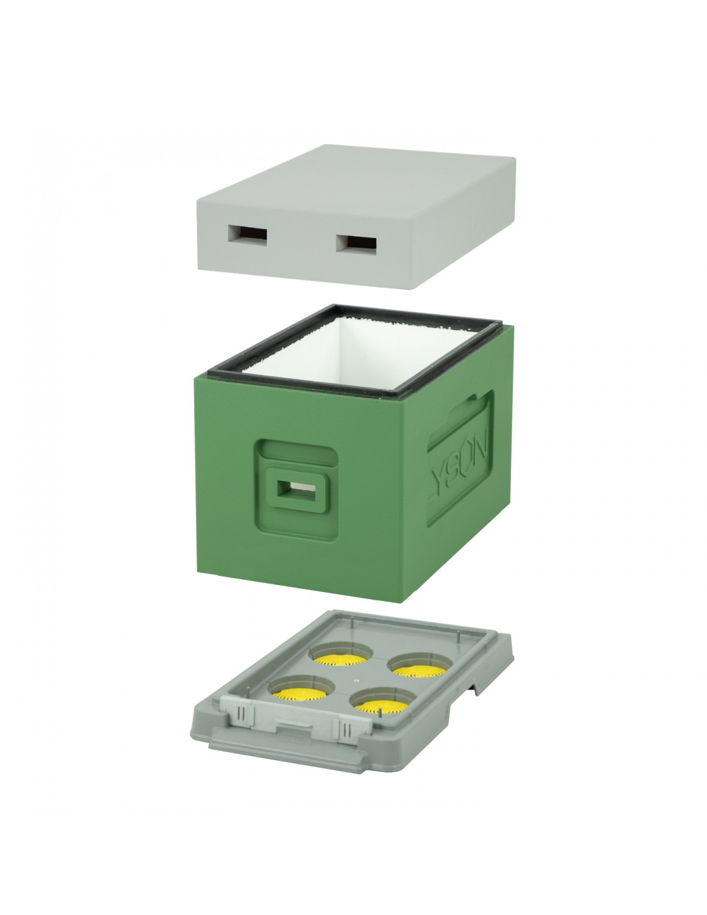
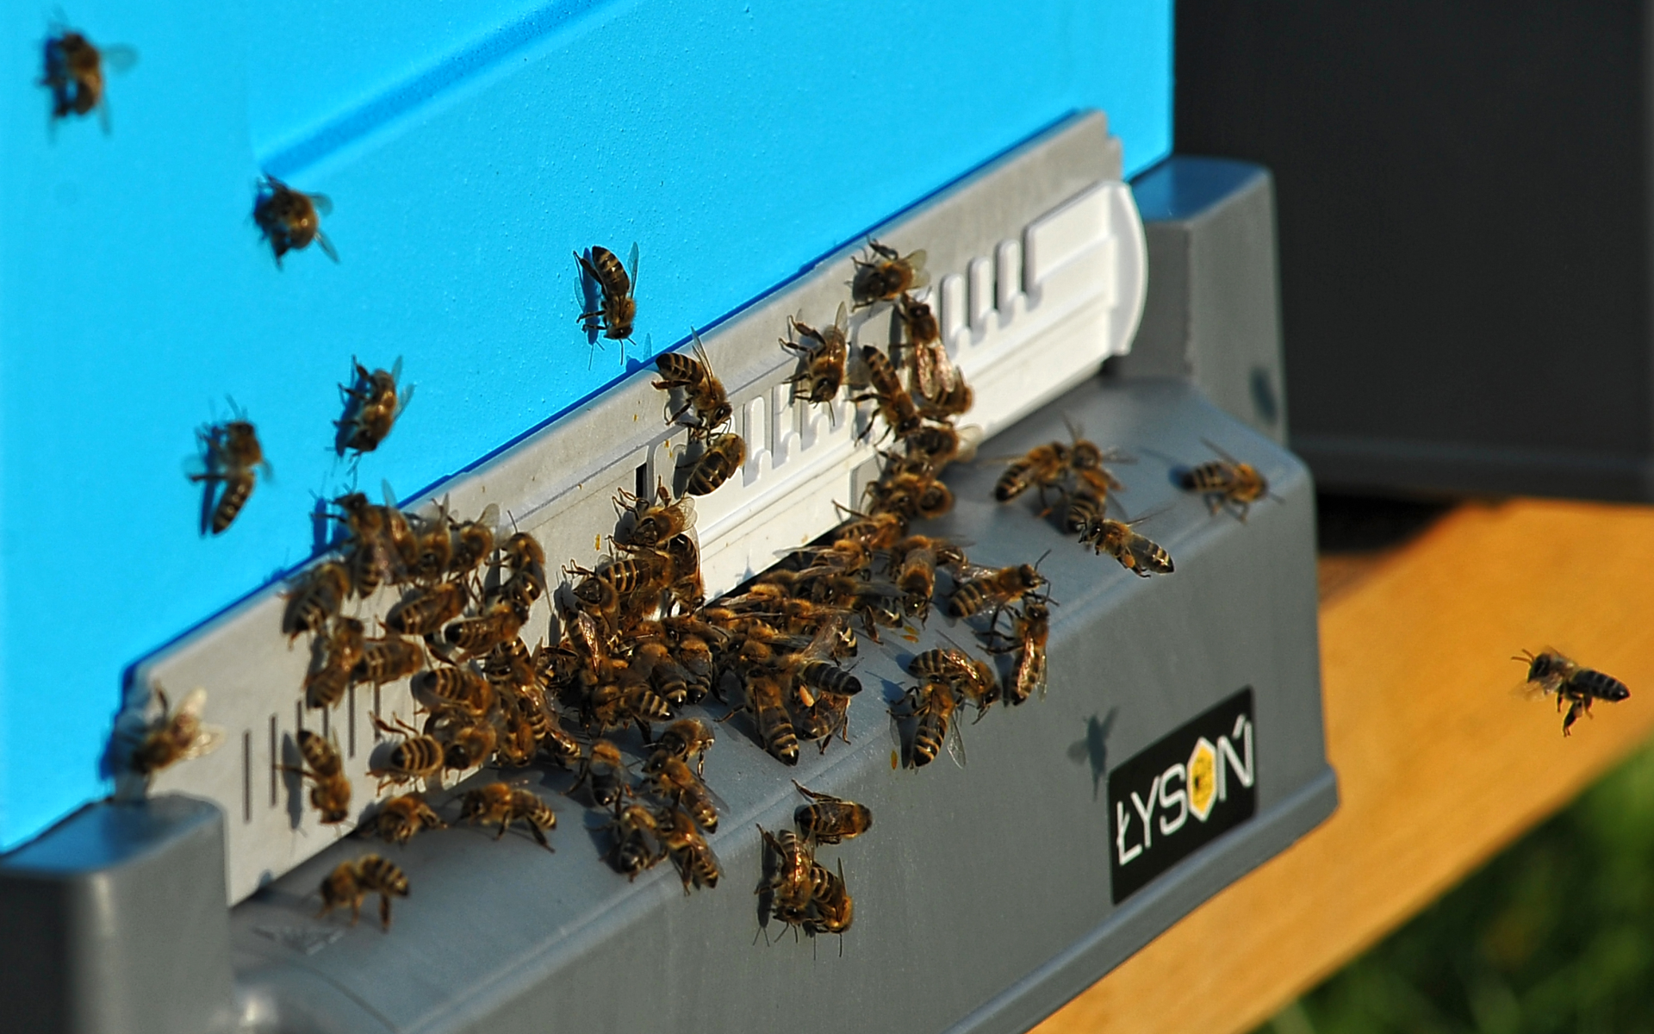
A strong and actively laying queen is one of the essential components of a successful honey bee colony. She provides a constant source of new workers. Through her pheromones, she helps to direct the activities that keep the colony healthy and productive. There are several scenarios, that will prompt a colony to naturally produce a new queen, but a skilled beekeeper can also trigger this action, using proper equipment and right methods.
INNOVATIVE BEEKEEPING
QUEEN REARING - SPECIALIZED HIVES
https://lyson.com.pl/ule-6-ramkowe-wielkopolskie-i-dadant/5355-ul-6-ramkowy-do-wychowu-pakietow-wielkopolski-malowany-z-wrega-zielony-seledynowy-5903661584238.html
https://lyson.com.pl/artykuly-pszczelarskie/page/2/

Slide 40
FOOD STORAGE AND TRANSPORT

Slide 41
Food and nutrition security, a major global challenge, relies on the adequate supply of safe, affordable and nutritious fresh and processed foods to all people. The challenge of supplying healthy diets to 9 billion people in 2050 will in part be met through increase in food production. However, reducing food losses throughout the supply chain from production to consumption and sustainable enhancements in preservation, nutrient content, safety and shelf life of foods, enabled by food processing will also be essential. Providing so many people with nutritious foods is a massive challenge and one that cannot be met by simply upscaling current practices regarding food production and consumption.
Providing humanity with nutritional food is at the center of all decisions related to sustainable development. Agriculture is responsible for 80% of global deforestation and the food systems release 29% of global greenhouse gasses. We use an area equivalent to North and South America combined for the production of meat for consumption or to produce the food necessary to feed the animals we eat. 70% of fresh water use is related to agriculture. These figures are staggering, and they show us, that we need to rethink and transform the way we produce, distribute and consume food worldwide.
There are are a few approaches to solving this issue and one of them is to impove the quality of storage and transportation of both raw materials for food processing as well as ready-made products. Proper storing and food preparation methods not only help to preserve the quality and nutritional value of the food products, but also help to prevent unnecessary losses of the produce and connected financial losses. Additionally, proper food storage can help prevent foodborne illnesses caused by harmful bacteria. Another benefit is that it increases the real income of the farmers, while also balancing out the surplus-scarcity cycle. This way, storage solutions greatly support food security. This turns storage solutions into as important an agricultural application as any other aspect.
FOOD STORAGE AND TRANSPORT
PATH TO FOOD SECURITY
https://www.sciencedirect.com/science/article/abs/pii/S0924224415301886
https://extension.colostate.edu/topic-areas/nutrition-food-safety-health/food-storage-for-safety-and-quality-9-310/

Slide 42
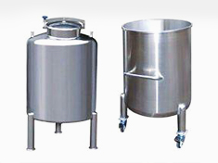
SPAWEXPERT is a Polish provider of welding services and manufacturer of all kinds of stainless steel products for the Polish and EU markets. Their standard offer includes manufactured stainless steel tanks for the food, chemical, pharmaceutical and cosmetics industries, along with quick delivery, assembly, high quality, and reasonable pricing.
They represent high quality craftsmanship and steel used to manufacture them supplied by proven and renowned suppliers only. Company’s experience, know-how, and individual approach to each project is an advantage when meeting customers' expectations, who are provided with full documentation, transport, assembly, and technical service.
The offer includes: horizontal and vertical tanks, single, double, and triple wall tanks insulated with cooling or heating jacket, pasteurisers, fermentation and conditioning tanks, mixers, CIP stations and many others. As for the application, it depends on the type of tank. Heating or cooling tanks are commonly used in the food industry to maintain a constant temperature of the contents inside or as a loading tank. Pasteurizer is a solution that can be used in milk, fruit juices, ice cream, bottled beer producing factories.
FOOD STORAGE AND TRANSPORT
SPAWEXPERT: FOOD STORAGE AND TRANSPORT
Fermentation and aging tanks are used in the alcohol industry, fruit and vegetable processing plants - for fermentation or aging of beer, wine, cider, juice. Mixers in the food industry are used for bulk materials and preparing mixtures of products. They are also used in industry - wherever the aim is to obtain a homogeneous mixture of two or more substances - usually in the form of powder.
https://spawexpert.pl/oferta/zbiorniki-ze-stali-nierdzewnej/

Slide 43
Tank Wash Group was established in 2004 in Slovakia. Tank Wash Group is an important partner in the supply chain in Slovakia, the Czech Republic and Poland. The company offers truck-cleaning services since its formation. Their goal is to offer complex services to our clients - individual approach and quality of service are theirs work fundamentals. Tank Wash s.r.o. has become an important partner in the supply chain in Slovakia, the Czech Republic as well as in Poland thanks to its excellent price/quality ratio, its adherence to the latest trends, and its efforts to meet customers' requirements.
Company’s services include: cleaning of chemical and food tanks, container tanks, force, isotherms, washing from the outside of trucks, IBC containers 1000 l, specialized disinfection of chemical and food tanks.
Pricing for the station in Czech Republic is shown below.
FOOD STORAGE AND TRANSPORT
TANK CLEANING SERVICES
https://www.tankwash.eu/gb/policy.html

Slide 44
ECO-FRIENDLY PRODUCT PACKAGING

Slide 45
With plastic packaging being no longer allowed in the EU since July 2021, and customers opting for disposable eco-friendly packaging, restaurants’ owners and food producers had to switch towards sustainable solutions.
Apart from this legislation, there are also other reasons to try eco-friendly packaging, such as to:
Reduce your Carbon Footprint - Compostable packaging is designed to break down into compost. This can then be used to enrich the soil, or even to grow new resources.
Demonstrate your sustainability knowledge to customers - Eco-friendly packaging lets your customers know that your brand is authentic in its commitment to sustainability.
Reduce Shipping Costs - Eco-friendly packaging minimizes the amount of packaging material used to ship goods, so it’s more economical to ship.
Reduce Contamination of Recycling or Compost -Mixed materials and standard adhesive labels used on otherwise compostable packaging can ruin efforts to recycle or compost by damaging machinery and contaminating the process.
Radpak meets the needs of both restaurant owners and food producers by providing them with high quality biodegradable disposable packaging, dishes and containers of the highest quality, which are widely used in the catering, gourmet and confectionery industry. The RADPAK company was founded in 1999 and operates in Krakow and its surroundings.
The company offers a wide selection of eco-friendly products of various capacities and shapes, such as bags, cups, containers, straws, cutlery, plates, bowls and many others, suitable for all kinds of goods for gastronomy, commercial establishments and service plants, for food manufacturers in the confectionery, processing, delicatessen and meat industry and others.. These products are most often made of sugar cane or wood, which guarantees resistance to a wide range of temperatures while protecting the environment, as well as products’ durability. For reasons mentioned above, biodegradable packaging is a perfect choice for most uses.
ECO-FRIENDLY FOOD PACKAGING
RADPAK: ECO-FRIENDLY FOOD PACKAGING
https://radpak.eu/
https://elevatepackaging.com/blog/why-choose-ecofriendly-packaging/

Slide 46
Cardboard packaging allows food to be packaged and transported safely. Cardboard boxes are an excellent way to make the company's offer available to a larger group of consumers, including those who care about the environment.
Sugar cane packaging - dishes made of this raw material are resistant to high temperatures and can also be heated in the microwave. These products are moisture resistant, therefore they can be used not only for serving but also for transporting soups or stews. Products made of sugar cane are characterized by high durability. Sugar cane is a safe eco-material which, unlike polystyrene, does not release harmful substances into food even at high temperatures . Sugar cane packaging is vapor permeable, so food does not steam in them.
Biodegradable dishes made of palm leaves are characterized by high aesthetic values. These products are made of dried plant material, which makes them very light, while retaining their unique properties. Dishes made of palm leaves are waterproof and resistant to a wide range of temperatures. The leaves come from the Areca palm. They fall naturally to make room for new leaves to grow. They are therefore collected only after they have fallen from the tree and are subsequently heat-pressed into the desired shape. No waste will be generated during the production or disposal of these disposable dishes. In a suitable environment, they decompose completely within two months .
Compostable and biodegradable bags made of natural raw materials, namely potato starch and cornstarch. These products are characterized by durability comparable to their plastic counterparts (biodegradable bags start to show signs of wear after a year of use). They are characterized by a rapid decomposition process, thanks to which the users can reduce the quantity of produced waste. All of the products belonging to this category meet European standards (EN 13432).
ECO-FRIENDLY FOOD PACKAGING
RADPAK: ECO-FRIENDLY FOOD PACKAGING
https://radpak.eu/opakowania-tekturowe/
https://radpak.eu/naczynia-z-trzciny-cukrowej/
https://radpak.eu/naczynia-z-lisci-palmowych/
https://radpak.eu/bio-reklamowki/

Slide 47
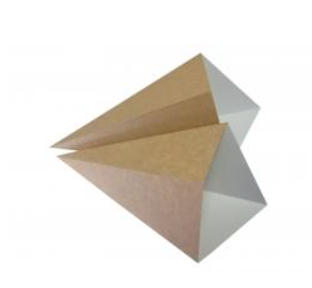
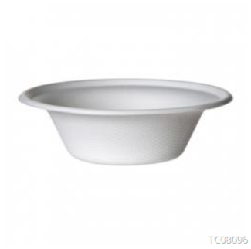
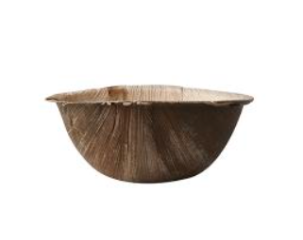
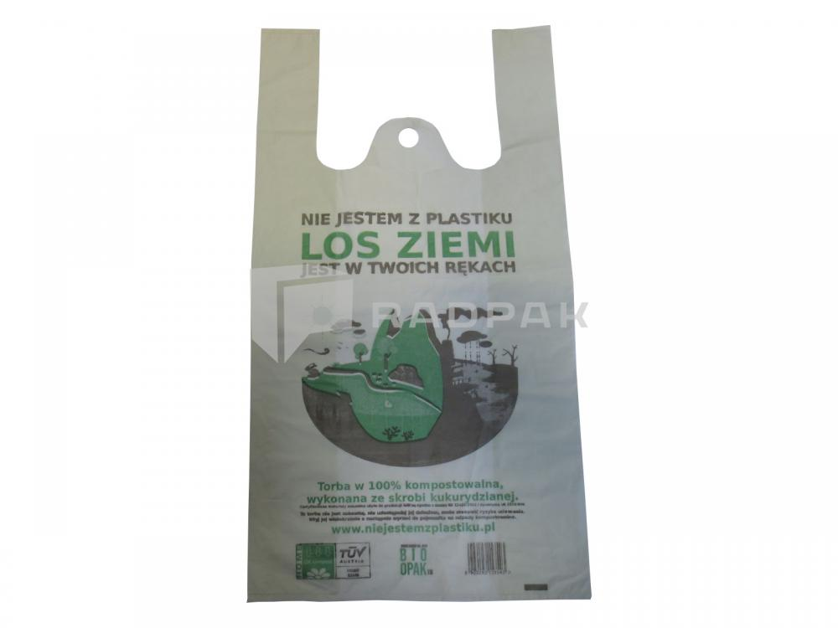
ECO-FRIENDLY FOOD PACKAGING
RADPAK: ECO-FRIENDLY FOOD PACKAGING
https://radpak.eu/opakowania-tekturowe/
https://radpak.eu/naczynia-z-trzciny-cukrowej/
https://radpak.eu/naczynia-z-lisci-palmowych/
https://radpak.eu/bio-reklamowki/

Slide 48
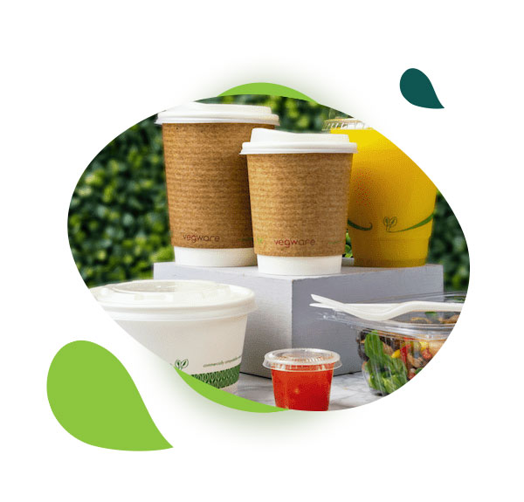
Bionela is a wholesaler of ecological compostable gastronomic packaging and dishes. At the same time, we run an e-shop where end customers can also buy organic products. Since 2013, we have been bringing a comprehensive range of organic gastro packaging and dishes from leading manufacturers to the Slovak market. The company is the exclusive represent of the Pacovis Naturesse, Biodora and Biopap brands in the Slovak Republic. They are a direct representative of ecological Vegware packaging in Slovakia. From the beginning, they work with a clear vision that our products will be of the highest ecological quality and will replace plastic packaging used once and ending up in landfills.
Bionela company is motivated by the belief that disposable packaging is a huge and unnecessary burden on the environment. Ecological packaging is a very broad concept and today there is a trend to label almost everything that is not made of plastic. Therefore, they want to be a guarantee that our customer will find gastro packaging in the highest and certified ecological quality without compromise.
ECO-FRIENDLY FOOD PACKAGING
BIONELA: ECO-FRIENDLY FOOD PACKAGING
The company’s goals include:
To follow trends and bring innovative materials and technological packaging solutions to the market.
To educate in the field of waste recovery and spread awareness about compostable materials.
To be a stable partner in the field of gastronomic services.
https://bionela.eu/o-bionele/

Slide 49
FOOD PROCESSING

Slide 50
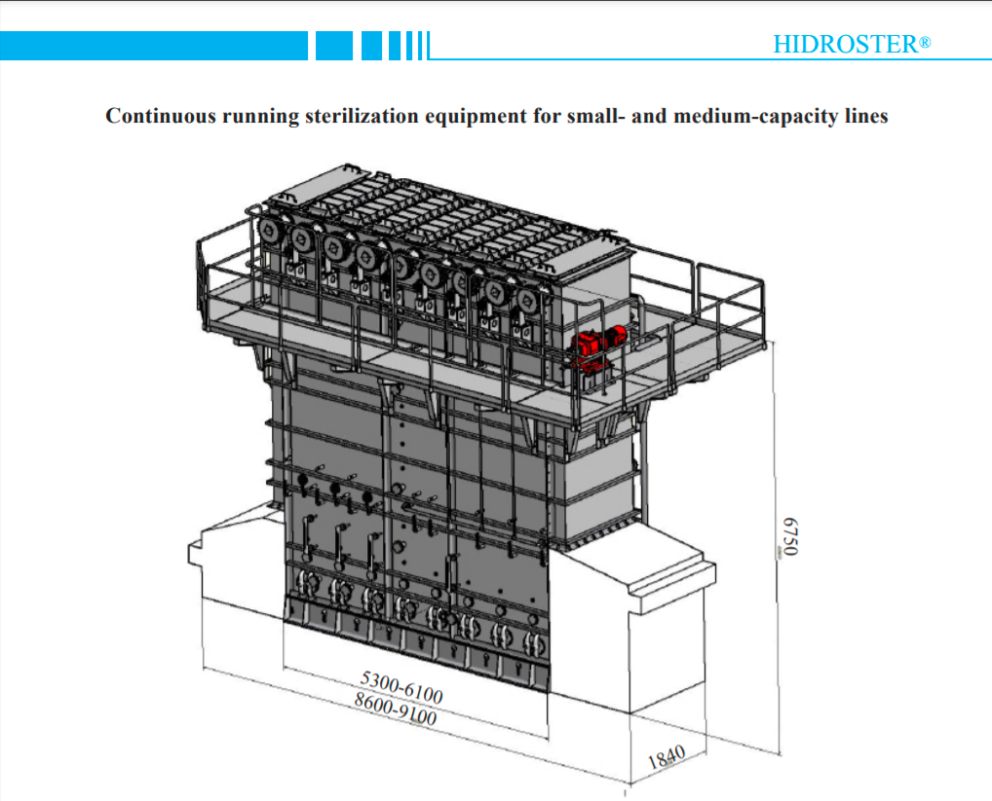
InnovaSter - Trade Kft is a Hungarian-owned, food equipment manufacturing company established in 1989 that manufactures equipment for food industry, supplies complete processing lines and canneries for production canned sweet corn, green peas, beans, cucumbers, tomatoes, etc. The company specializes in manufacture sterilization and pasteurization equipment. Company’s main product is the high capacity and high energy-efficiency, continuous running hydrostatic equipment for sterilization canned food and beverages in different packaging: HIDROSTER®. The equipment is designed and developed by InnovaSter-Trade Ltd for many years, and it is a company’s patent. Besides, company manufactures other equipment for food industry: autoclaves, special autoclaves, pasteurizers, stone separators, product washers, conveyors, tanks, and pressure vessels, welded constructions from stainless and acid-resistant steel. InnovaSter-Trade Ltd. performs turnkey projects from concept and designing to commissioning. All the equipment is made by customer’s requirements.
FOOD PROCESSING
INNOVASTER: DEVICES FOR FOOD PROCESSING
Fields of expertise:
Main product: HIDROSTER®
High-capacity, high energy-efficiency, continuous running equipment for sterilization
canned food and beverages, packaged in cans, glass jars, bottles, plastic bottles, foil,
bags, etc., at temperature up to 134 Celcius degrees:
Canned vegetables and fruits: sweet corn, green peas, etc.
Canned meat and fish products
http://www.innovaster.hu/cim_hun.htm

Slide 51
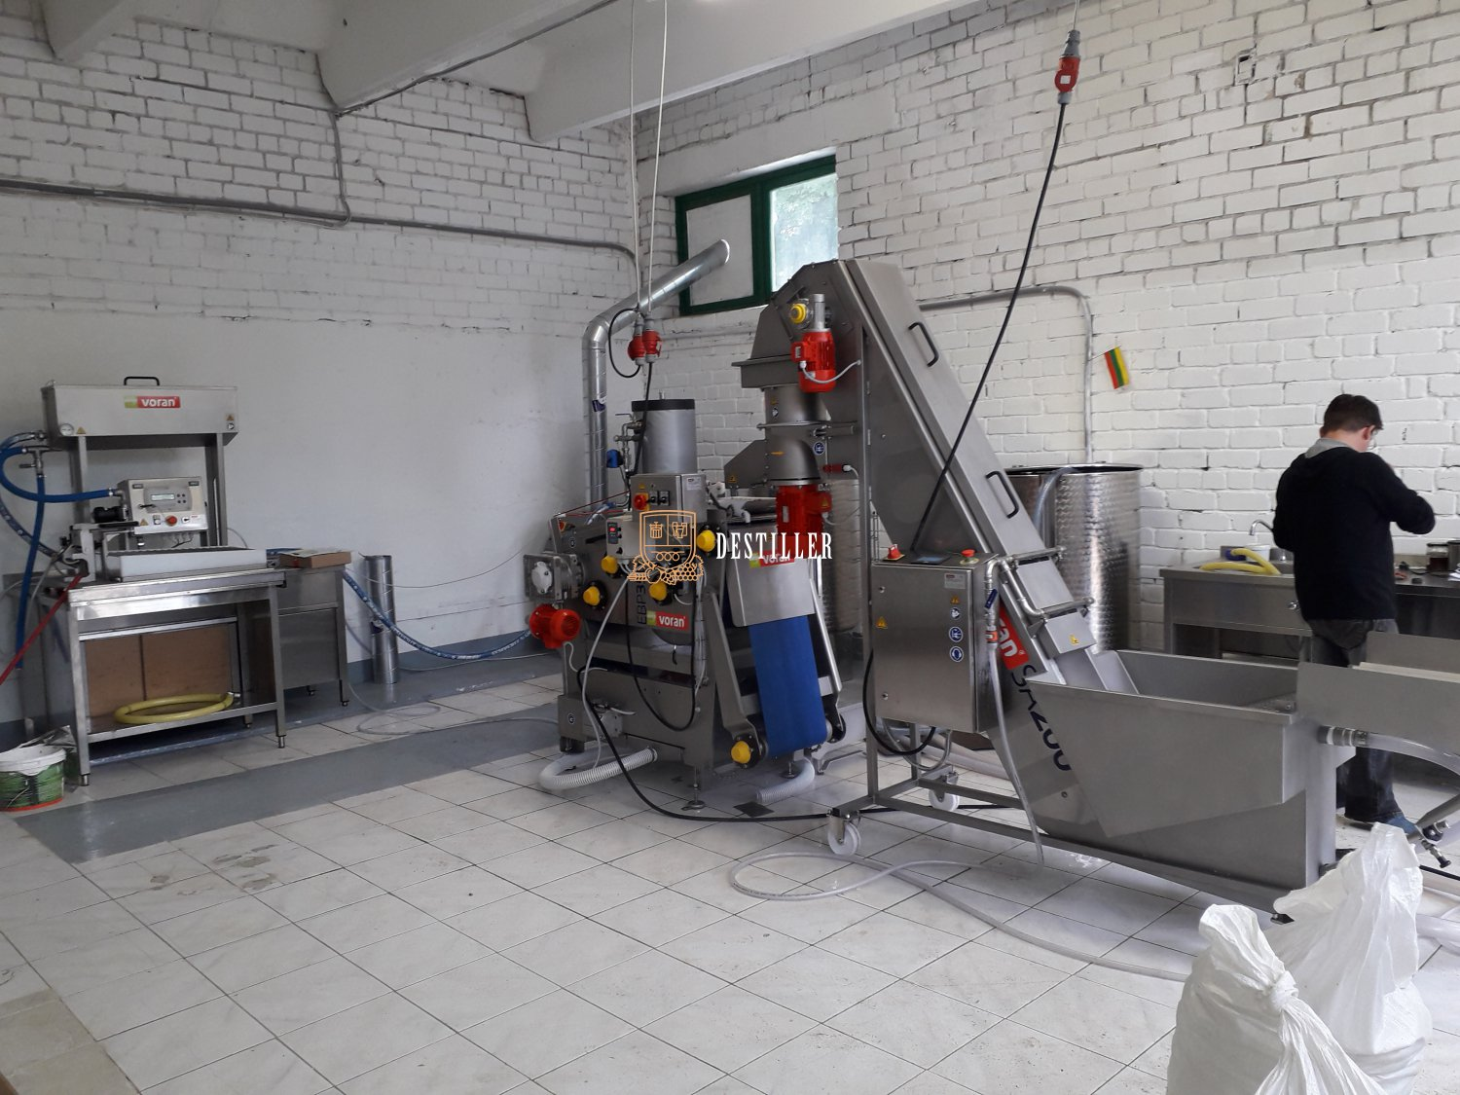
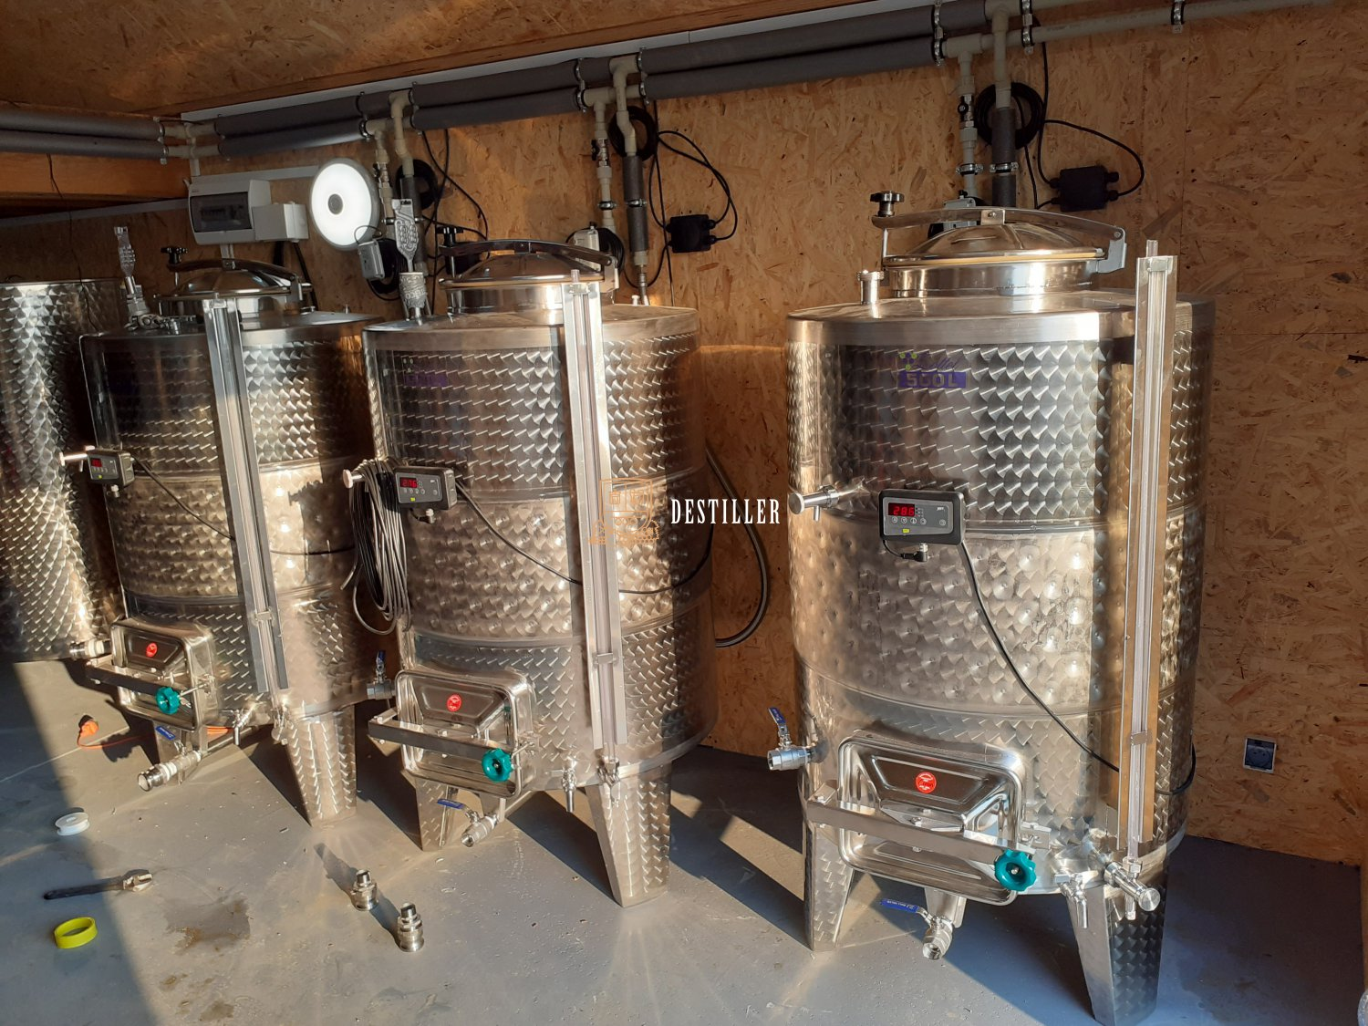
DESTILLER is a company offering food processing machines, such as: presses for fruits and vegetables, washing and milling machines, centrifugal mills (crushers) for fruits and vegetables, de-stonners, destemmers, pumps, filters, pasteurisers, NFC juice processing lines, boiling pans, vacum evaporartor filling, rinsing systems, capping machines, labelling machines and tanks. The company also offers fermentation tanks for cider, beer and wine production, as well as barrels and labelling devices. Their juice press offer includes lines with the capacity of 150 or 300 kg of fruit or vegetables per hour, perfect for small farms. These lines require more manual operation. We also recommend professional, fully automated fresh juice press lines with a capacity of 300, 700, 1500, 3000, and 7000 kg of fruits or vegetables per hour, and they are approved by professional fresh juice presses.
Below you can find their sample projects, including: juice press and complex cooling system.
FOOD PROCESSING
DESTILLER: FOOD STORAGE AND TRANSPORT
https://en.destiller.pl/shop/our-chosen-ones-realizations

Slide 52
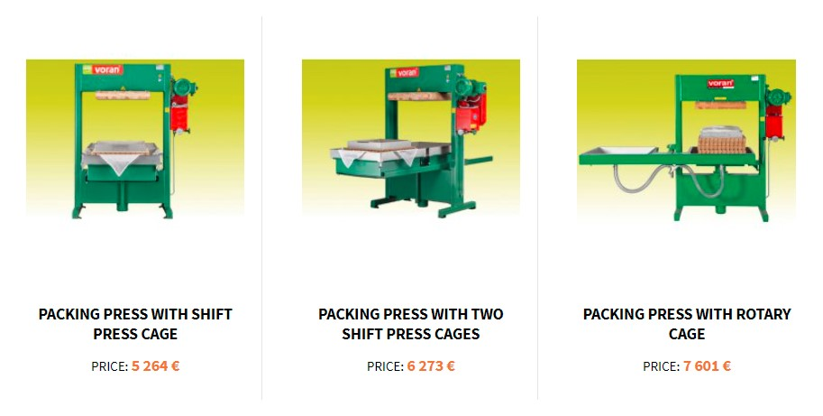
The basket press presses the plant material down to the bottom, extracting juice and keeping skins and seeds out of the must. This is achieved with a heavy, cast iron plate. The plate is operated using either a hydraulic or screw device. The juice is forced out though space between the panels of the basket or barrel. Destiller offers basket presses with pivoting round basket and hydraulic power unit. The device is easy and safe to operate, thanks to automatic pressure relief valve on hydraulic power unit.
Processable raw materials: grapes, apples, vegetables, pears, carrots, quince, manioc, beetroot.
FOOD PROCESSING
DESTILLER: BASKET PRESS
https://en.destiller.pl/we-recommend/machine-and-equipment-voran

Slide 53
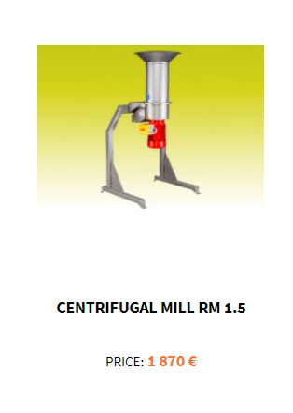
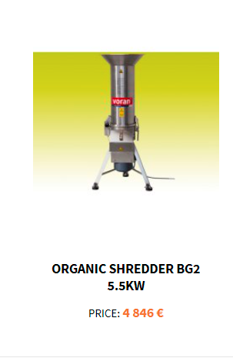
Centrifugal mill with replaceable stainless steel screens for adjusting the degree of shredding for pomaceous fruit, stone fruit and berries. Available with frame as option.
The organic chipper is a multipurpose grinder in stainless steel. It is suitable for grinding vegetable, white / brown bread remnants (waste bread grinder) as well as producing breadcrumbs, grinding nuts (before roasting), grating cheese and spices and crushing corn / grain. The degree of grinding is adjusted using a range of easy-to-change screens. The multipurpose grinder can thus be used for grinding a wide selection of foodstuffs and organic waste. Processable materials, examples: organic waste, grain, waste bread, nuts, spices, vegetables, blueberries, manioc, tomatoes.
FOOD PROCESSING
DESTILLER: CENTRIFUGAL MILLS AND ORGANIC SHREDDERS
https://en.destiller.pl/we-recommend/machine-and-equipment-voran

Slide 54
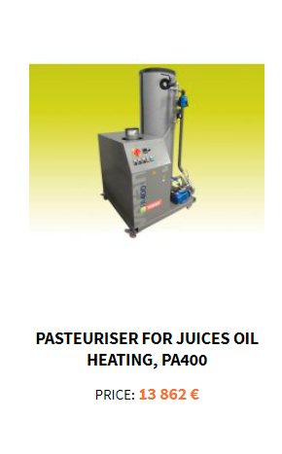
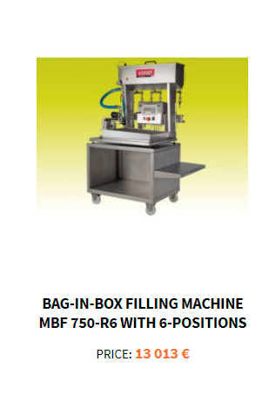
Oil-fueled pasteurizer, nominal rating: 400 l/h, fuel consumption: 3,5 l/h.
Manual Bag in Box filling system with feed line vessel for hot filling of fruit and vegetable juice in 3, 5, 10 and 20 l standard bags and 0.25 - 2 l bottles. Bag in Box system’s advantages include: extended product shelf-life, transportation and storage savings, user friendly dispensing, safe and hygienic filtering process.
FOOD PROCESSING
DESTILLER: JUICE PRODUCTION AND PACKAGING
https://en.destiller.pl/we-recommend/machine-and-equipment-voran
https://www.liquibox.com/products/bag-in-box/

Slide 55
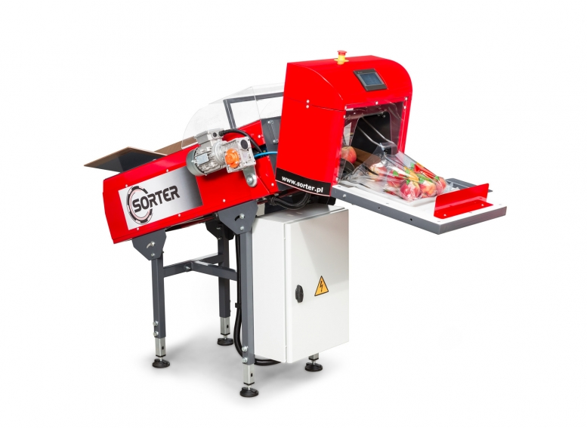
SORTER company was founded in Radom, as the only manufacturer of machines and equipment for sorting fruits and vegetables in Poland and Central-Eastern Europe, laying the foundation for the development of this industry in Poland. From the beginning, the company was guided by the vision of developing new standards to compete not only in the domestic market, but also globally. Innovation and quality of workmanship, creating its own innovative and bold projects and gaining the trust of customers by offering high quality and reliability of machinery and equipment have become the most important factors that have influenced the current position of the company. Goods signed with the SORTER mark have become sought after not only in Poland.
The leading business profile of SORTER is the production and sale of advanced technological solutions, including innovative ones in many areas, from sorting, through product packaging, to palletizing and robotics.
FOOD PROCESSING
SORTER: DEVICES FOR FOOD PROCESSING
The company offers a whole range of devices:
technologically advanced production lines,
electronic sorting machines for fruits and vegetables,
fruit and vegetable processing machines,
precision manipulators and industrial robots,
high quality palletizing systems,
automatic packaging and storage systems,
orchard equipment.
https://www.sorter.pl/pl/firma/o-firmie,515.htm

Slide 56
The company provides various technologically advanced fruit sorting lines, designed for apples, tomatoes, peaches, citrus fruits, pears, plums and cherries.
The classification parameters for these devices include:
Size - the classification of apple according to the size, proceeds through the analysis of a series of images including characteristics of apple (e.g its shape)
Weight - using the electronic strain gauges, digital signal filtration and the reduction of noises,fast and cutting edge weight module enables precise calculations on sorted apples in real time thus significantly shortening the measurement time.
Colour - the cameras installed in the vision system analyze a series of images and enable recognition of the product according to the colour.
Internal and external quality - using the cameras the vision system inspects product surface and recognizes external damages (e.g. apple scab, defects due to mechanical cause) as well as internal (damages under the peel).
Sorter’s algorithms allow to analyse products in real time. Due to this innovative solution specific parameters of the products are calculated. Algorithms designed by Sorter distinguish the system from similar visual systems, which are based on a comparison of products’ images with the standard pattern.
The software can be adapted to any sorting machine, which enhances sorting processes. System configuration can be customized to customers’ needs. The company guarantees constant quality due to certified durable stainless steel components and consistent performance. User-friendly interface enables easy change of the parameters in real time.
FOOD PROCESSING
SORTER: DEVICES FOR SORTING
https://www.sorter.pl/en/sortingmachines1/apples,1432.html

Slide 57
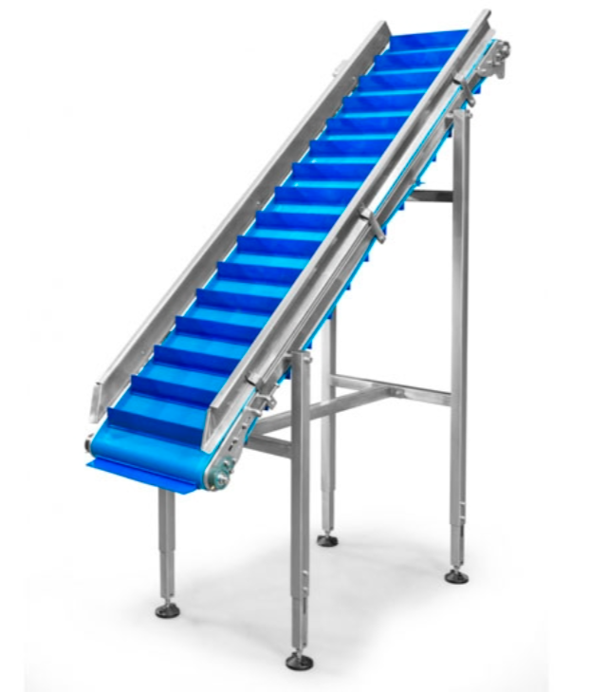
Sorter's offer has been extended by a range of devices for fruit and vegetable processing.
Each designed and implemented line is unique because it is made to individual customer order according to his guidelines. Designed installations are characterized by durability, due to the high quality components.
FOOD PROCESSING
SORTER: FRUIT AND VEGETABLE PROCESSING
The company offers:
hydraulic tippers
brushers and water-air washers
conveyors: rollers, gravitational, lifting
fruit dryers
waxing machines
electronic sorting machines
machines for cutting and peeling fruit and vegetables
weighing and packing machines
fruit counting machines
palletisers and pallet destackers
packing tables and automatic packing machines
innovative vision systems for quality control in the production line
https://www.sorter.pl/pl/firma/o-firmie,515.htm

Slide 58
Czech company Farmet developed exclusive technology combining Pressing with Extrusion. This combination of both technologies will ensure the best results for the processing of oilseeds, especially for soybeans, rapeseed and sunflower, for the purpose of feed production.
The lowest operation costs owing to the Farmet technology, which uses an advanced system of energy recuperation.
Hexane-free technology Farmet that is both cost-efficient and environment-friendly.
Hexane-free technology Farmet brings you an ideal feed with an optimal ratio of fat (energy) and proteins.
Hexane-free technology Farmet gives you the most effective feed at minimal costs.
The different modifications and possible arrangements of the presses provide a broad range of solutions for concrete requirements on the pressing process: from very small capacities for the pressing of special oilseeds to large facilities processing 1000 tons daily. Due to the different properties of each oilseed variety, mainly oil content, the technology always needs to be precisely adjusted for the particular species, variety, or seed category.
FOOD PROCESSING
FARMET: COMPLEX OILSEED PROCESSING
https://www.farmet.cz/en/complex-oilseed-processing

Slide 59
Vegetable oil obtained through pressing or extraction contains naturally occurring undesirable impurities that prevent direct use of the oil for food and technical purposes. These impurities can be categorized according to their solubility in oil.
The particles insoluble in oil can be pieces of seeds that enter the oil during its processing. Oil-soluble substances include mainly phosphorus (bound to phospholipids), resin, pigments, wax, and volatile particles. These substances may cause undesirable colouration, unwanted odour at higher temperatures, and burning at contact surfaces, all of which hinders the use of the oil in food and technical industry. Farmet offers technological equipment for filtration and purification of the oil per customer’s wishes. They adapt this technology according to each customer’s demands and quality requirements, as they offer complex support in terms of choosing proper machines and first steps with the devices.
The company offers devices for the following purposes:
Degumming - the technology of removal of phosphorus from crude oil.
Oil bleaching - a step in the process of crude oil refining. In the bleaching technology, bleaching earth is applied to crude oil, minimizing its content of vegetable pigments, heavy metals, and the phosphorus remaining after degumming, which improves the appearance and taste of the oil.
Dewaxing process, which is only intended for sunflower oil. This is because of the wax that penetrates the oil from seed hulls and causes higher turbidity (cloudiness) or a sediment at the bottom of the vessel. Dewaxing leads to a purer and tastier oil.
The goal of deacidification is the removal of naturally occurring substances that cause unwanted smell and taste. These volatile substances vaporize at higher temperatures, then condense and stain surrounding surfaces (for example, kitchen walls). Their removal can be done using distillation columns.
FOOD PROCESSING
FARMET: VEGETABLE OIL PROCESSING
https://www.farmet.cz/en/oil-processing

Slide 60
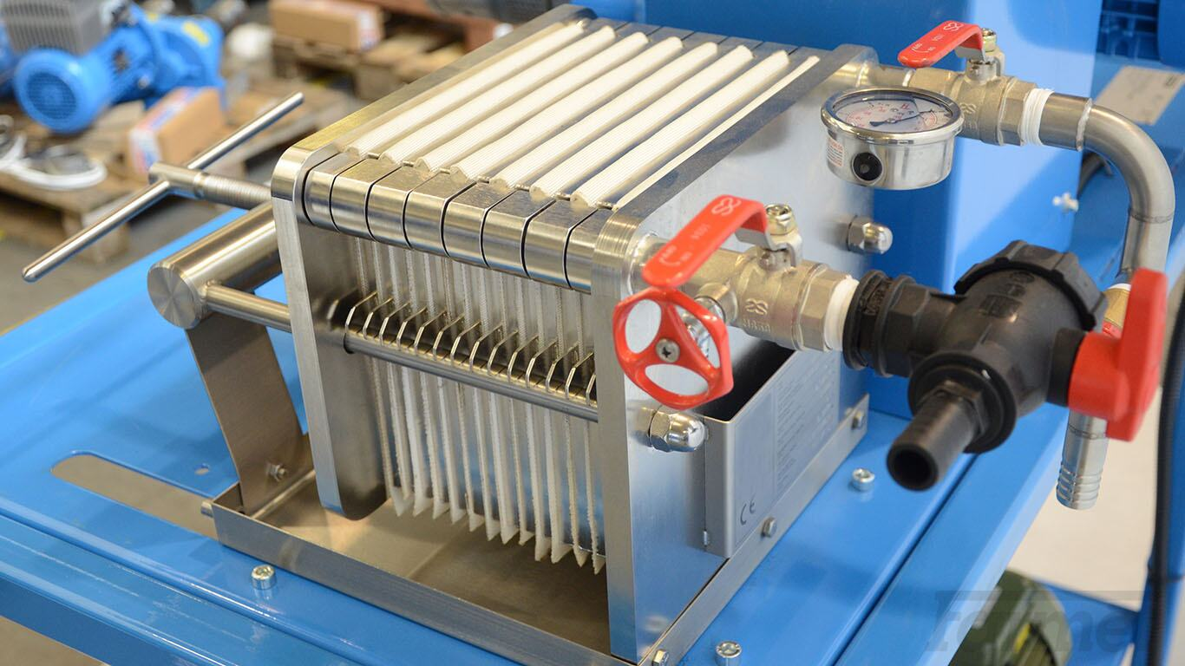
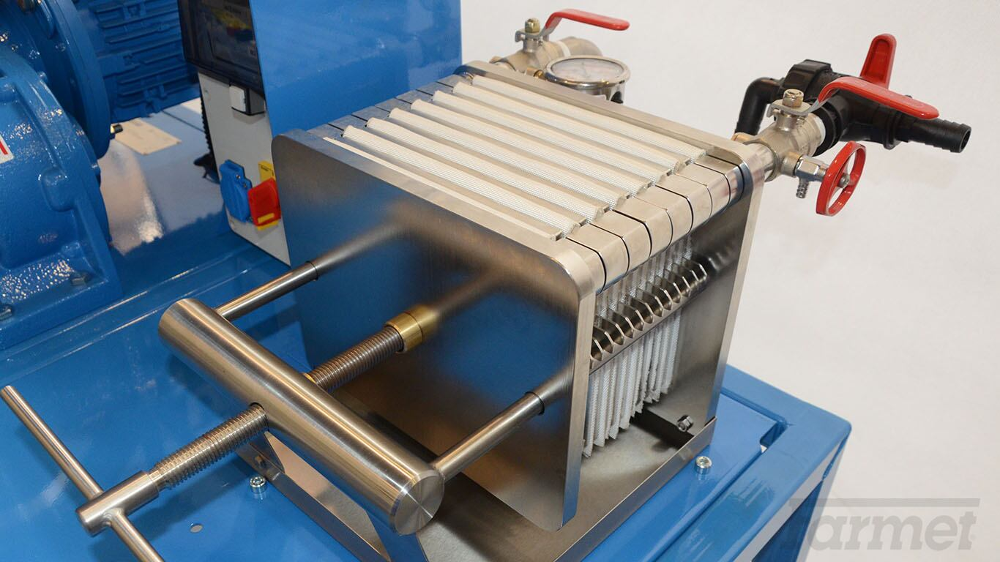
Plate filters represent an optimized solution for small-scale and middle-scale press shops. These filters offer superb filtration parameters at low running costs and purchase price. Maintenance of our filters is made easy thanks to their simple yet extremely robust design. The plate filter, where the process of vegetable oil filtration takes place, consists of stainless steel front plates, stainless steel filtration frames, guide pivots, a crosspiece, and a central screw with an operating wheel and a drainage bowl.
In between the frames, filter cloths are inserted. Filter cloths come in different mesh sizes corresponding to desired purity of the filtrate. As the liquid passes through, the cloths collect the impurities. The materials that come into contact with the filtered liquid are safe for human health.
FOOD PROCESSING
FARMET: VEGETABLE OIL PROCESSING - PLATE FILTERS
https://www.farmet.cz/en/plate-filters#tab-CustomContent

Slide 61
The technology of filtration offered by Farmet represents an effective solution for removing mechanical impurities from raw oil. The equipment can be used for multiple types of oil.
Automatic filtration is designed for vegetable oil filtration, especially for the removal of solids, which are introduced during oilseed pressing. The technology of automatic filtration stems from Farmet’s extensive experience with raw oil processing. Its main advantage is a highly sophisticated control system that allows optimization of the filtration process in accordance with the properties of raw oil. The technology is also always optimized to meet particular requirements of the customer.
The crude, solids-containing oil is accumulated in the mixing tank. Filtration is performed periodically in the pressure leaf filter. The filter itself consists of a cylindrical vertical pressure container with a conical bottom that ends with a drainage valve and a lid. The container is furnished with extensions for pipes and sensors (for pressure and levels). Operation of the filter meets specifications for pressure containers. Filtration plates are fixed on the inside of the filter. At the neck of the filter, there is a vibrator that serves to shake off the dried up filter cake out of the filtration plates.The filter is connected with the mixing tank through piping with built-in, pneumatically operated valves and pumps. Operation of the filter is controlled automatically by a PLC equipped with our control system FIC – Farmet Intel.
This technology is offered for middle- and large-scale press shops.
FOOD PROCESSING
FARMET: VEGETABLE OIL PROCESSING
https://www.farmet.cz/en/oil-processing

Slide 62
Maintenance of diverse crops on the farm requires not only the knowledge on varieties best suited for the given region, but also on the ability to process the obtained harvest, in order to increase the income through product’s added value. Farmers and other maintainers may abandon local crop varieties if there is no comparative advantage to them in cultivating them.
Creating stable value chains for crop produce is one option that is widely considered to be central in efforts to promote their sustainable use. This can involve a range of stakeholders, including farmers and farmers’ cooperatives, local promotional associations and businesses, research and development organizations, food processing companies, and local government agencies. To enhance marketing options, value-adding measures include the development of new products from raw sources, the use of high quality processing methods and packaging, and registration through schemes such as geographic indications and traditional specialities. Products may be sold in local markets, grocery shops, supermarkets and via Internet-based outlets, as well as to restaurants.
The value of a product or service can be increased at different stages of its production or delivery by the addition of features for which consumers are willing to pay more. The key element to successful initiatives is a clear market orientation. Added value can start at the farm with basic processing of primary products, such as heat-processing, pressing, fermenting or drying.
Polish company Alfapure provides food processing equipment suitable for home-based users and small manufacturers, that can help with micro-scale crop processing, thus adding value to produced crops.
FOOD PROCESSING
ALFAPURE: EQUIPMENT FOR MICRO-SCALE PRODUCTION
https://alfapure.pl/
http://www.fao.org/plant-treaty/tools/toolbox-for-sustainable-use/sustaining-local-crop-diversity/en/
https://enrd.ec.europa.eu/sites/default/files/publi-enrd-rr-22-2016-en.pdf#page=4

Slide 63
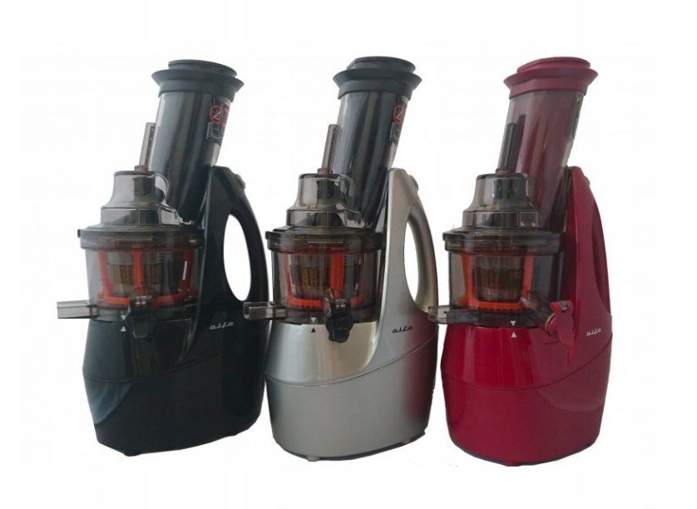
Their offer includes renowned Alfa 4G slow juicers, which work on the principle of a hydraulic press, with very little oxidation and little breakdown of nutrients happening, the user obtains juice of high quality. Slow juicers are slow because they need to use a pressing force to get the juice through the filter without creating too much heat and friction. A low speed induction motor is needed for that pressing force. The speed is simply a necessary aspect of the juicing process in each case. The hype about nutritional content is secondary to the mechanical limitations of the juicing process. During the squeezing process less foam is formed and the juice does not delaminate.These products are suitable for juicing most fruits, all vegetables, herbs and all greens.
Nazwa rozdziału
FOOD PROCESSING
ALFAPURE: SLOW JUICERS
https://alfapure.pl/wyciskarki-alfa-4g/11-wyciskarka-alfa-4g-burgund.html

Slide 64
Cold pressed oils have gained popularity over the last few years and they are now perceived as a superfood. Cold pressed retain healthy antioxidants that are otherwise damaged by being exposed to heat. Antioxidants help combat free radicals that cause cell damage in the body. Most cold pressed oils are rich in vitamin E, which has anti-inflammatory and healing properties. They are also rich sources of oleic acid that help boost your immune system. All these oils when cooked on low heat are excellent oils; however, they lose all the nutrients once exposed to too much heat.
Because of their short shelf-life and high nutritional values, they are much more expensive than refined fats or rapeseed oil. Regarding these properties, its wise to own intuitive, low-maintenance and easy to use oil press. The user can press oil from almost all grains and seeds, such as: sunflower, walnuts, hazelnuts, peanuts, pine nuts, cashews, sesame, nigella, pumpkin seeds or even coconut chips. The cost of buying a home press is a wise investment, since these devices cost around 500 euros each and can offer so many benefits, including major savings and minimizing the waste. In case of producing surplus amount of oils - it is easy to sell these fresh, homemade products to neighbours or tourists.
Another group of products that the company offers are dehybridizers - devices used to dry fresh products. Drying or “dehydrating” food is a method of food preservation that removes enough moisture from the food so bacteria, yeast and molds cannot grow. The temperature range of the producer's products is from 40 ° C - 70 ° C, and the user can change the time or temperature of the drying process before or during the process. The drying time range is from 00:30 to 72 hours, in 30 minute increments. Using this machine, the user can successfully dry fruits, vegetables, mushrooms, pre-prepared breads, pancakes and other food products including meat.
Nazwa rozdziału
FOOD PROCESSING
ALFAPURE: OTHER EQUIPMENT
https://alfapure.pl/prasy-do-oleju-alfa/93-prasa-do-oleju-alfa-zielona.html

Slide 65
“Precision farming” [online] https://ec.europa.eu/eip/agriculture/en/digitising-agriculture/developing-digital-technologies/precision-farming-0 [accessed: 10.08.2021]
“Solano Local Food System Alliance” [online]
https://cultivatecommunityfood.coop/solano-local-food-system-alliance/ [accessed: 10.08.2021]
“Ecotourism and Sustainable Development, 2nd edition – By Martha Honey”
https://onlinelibrary.wiley.com/doi/full/10.1111/j.1477-8947.2009.01256.x [accessed: 13.08.2021]
“DECENTRALIZED WASTEWATER TREATMENT CAN BE GREEN AND SUSTAINABLE” [online]
https://www.epa.gov/sites/default/files/2015-06/documents/mou-green-paper-081712-v2.pdf [accessed: 10.08.2021]
“Conventional methods of sewage disposal” [online]
http://www.waldeneffect.org/blog/Conventional_methods_of_sewage_disposal/ [accessed: 10.08.2021]
“How does a SBR water treatment work?” [online]
https://www.graf-water.com/wastewater-treatment/all-about-wastewater-treatment/how-does-a-sbr-wastewater-treatment-system-work.html [accessed: 10.08.2021]
“Grey water as a part of in-building water cycle” [online]
https://www.irbnet.de/daten/iconda/CIB_DC27602.pdf [accessed: 10.08.2021]
“Modern Beekeeping” [online]
https://www.trendhunter.com/protrends/modern-beekeeping [accessed: 10.08.2021]
“Queen Rearing Methods and Equipment” [online]
https://www.dadant.com/learn/queen-rearing-methods-and-equipment/ [accessed: 10.08.2021]
“Why Choose Eco-Friendly Packaging?” [online]
https://elevatepackaging.com/blog/why-choose-ecofriendly-packaging/ [accessed: 10.08.2021]
“Smart and competitive food and drink supply chains” [online]
https://enrd.ec.europa.eu/sites/default/files/publi-enrd-rr-22-2016-en.pdf#page=4 [accessed: 10.08.2021]
Reference Guidebook with solutions regarding biodiversity protection and sustainable agriculture: practices from V4 countries
REFERENCES:

Slide 66
Material prepared under the project Farm to Fork Academy: V4 for Sustainable Agriculture in Albania, supported by the International Visegrad Fund and implemented by Albanian Network for Rural Development, in partnership with Rural Parliament in Slovakia, Hungarian National Rural Network, Local Action Group „Vistula – Terra Culmensis” and Czech-Moravian Association of Agricultural Entrepreneurs

